Slide 1
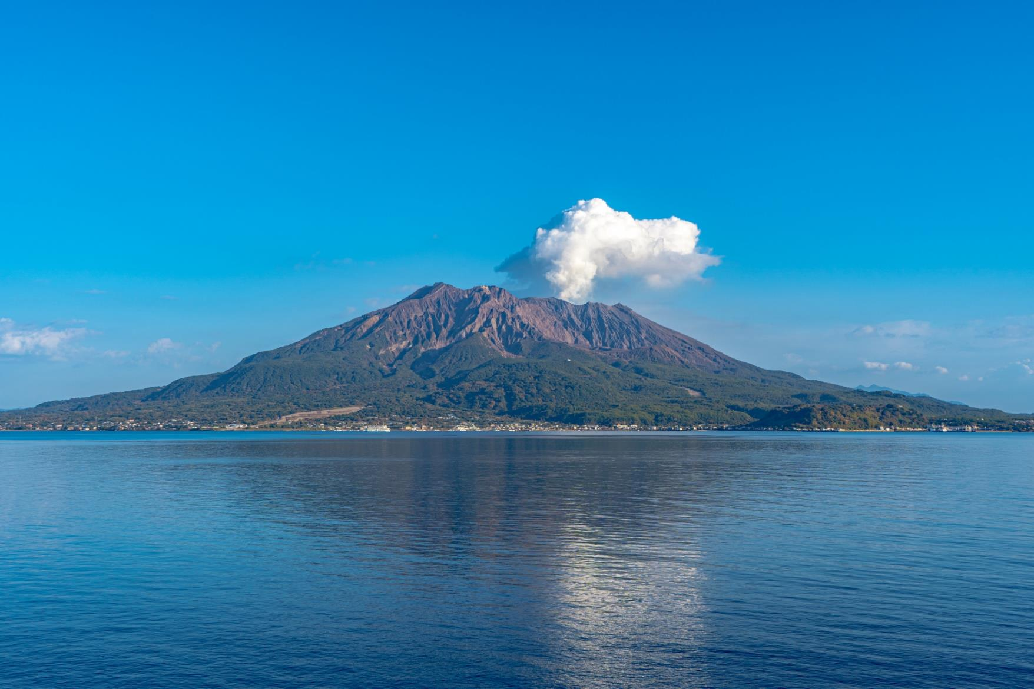
2024 Kyushu Area Trip
10 days trip
to visit all 7 prefectures of Kyushu and enjoy
nature and 3 famous hot springs

Slide 2
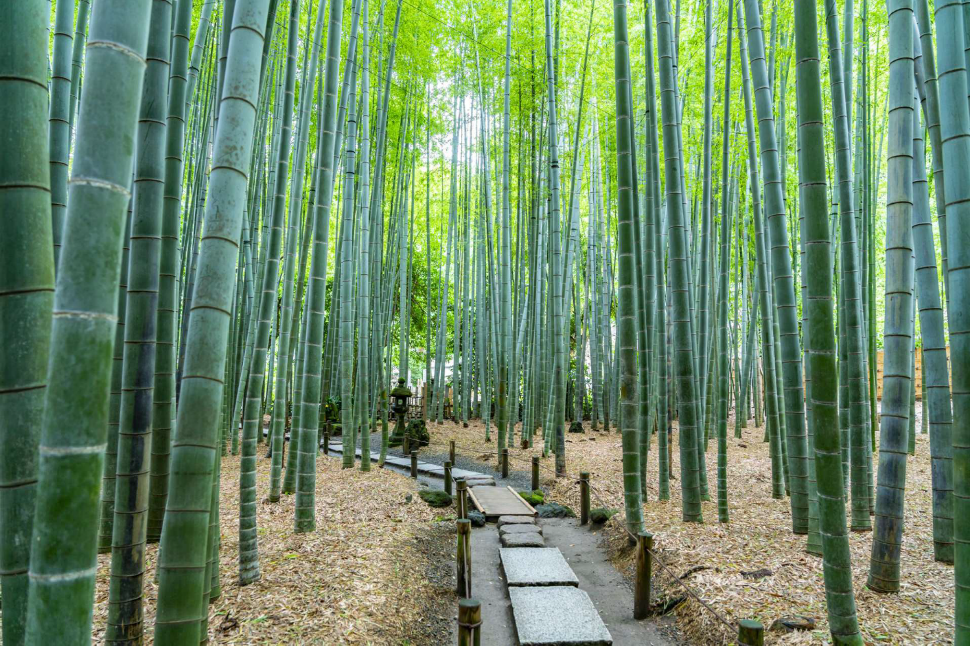
Thank you for your enquiry about Japan Travel
I have prepared an original itinerary。これをベースに日数、観光、ホテル、食事等、お客様の希望にあわせアレンジします。
I will do our best to make this a memorable and wonderful trip for everyone.
During the trip, I don‘t try to keep you in a tight spot like in a group tour. We will
consult with you about your physical condition, your mood and the weather on the day , foods, and arrange your trip freely.
It will surely resonate with your ‘’’six senses‘’
Sawakami Tours

Slide 3
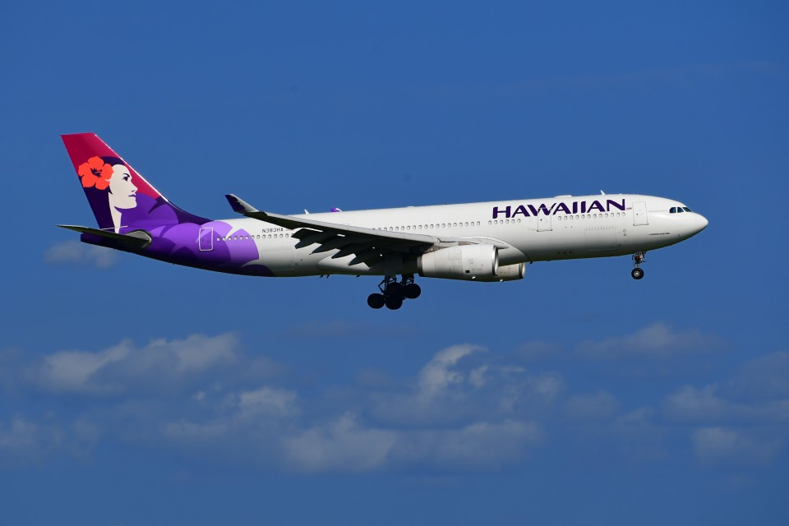
Day1 Hawaii to Japan(Fukuoka Apt)
Day2 Arriving Fukuoka
Leaving Hawaii to Japan!
On this trip, “Special memories of Japan just for you”
I hope you can make it!

Slide 4
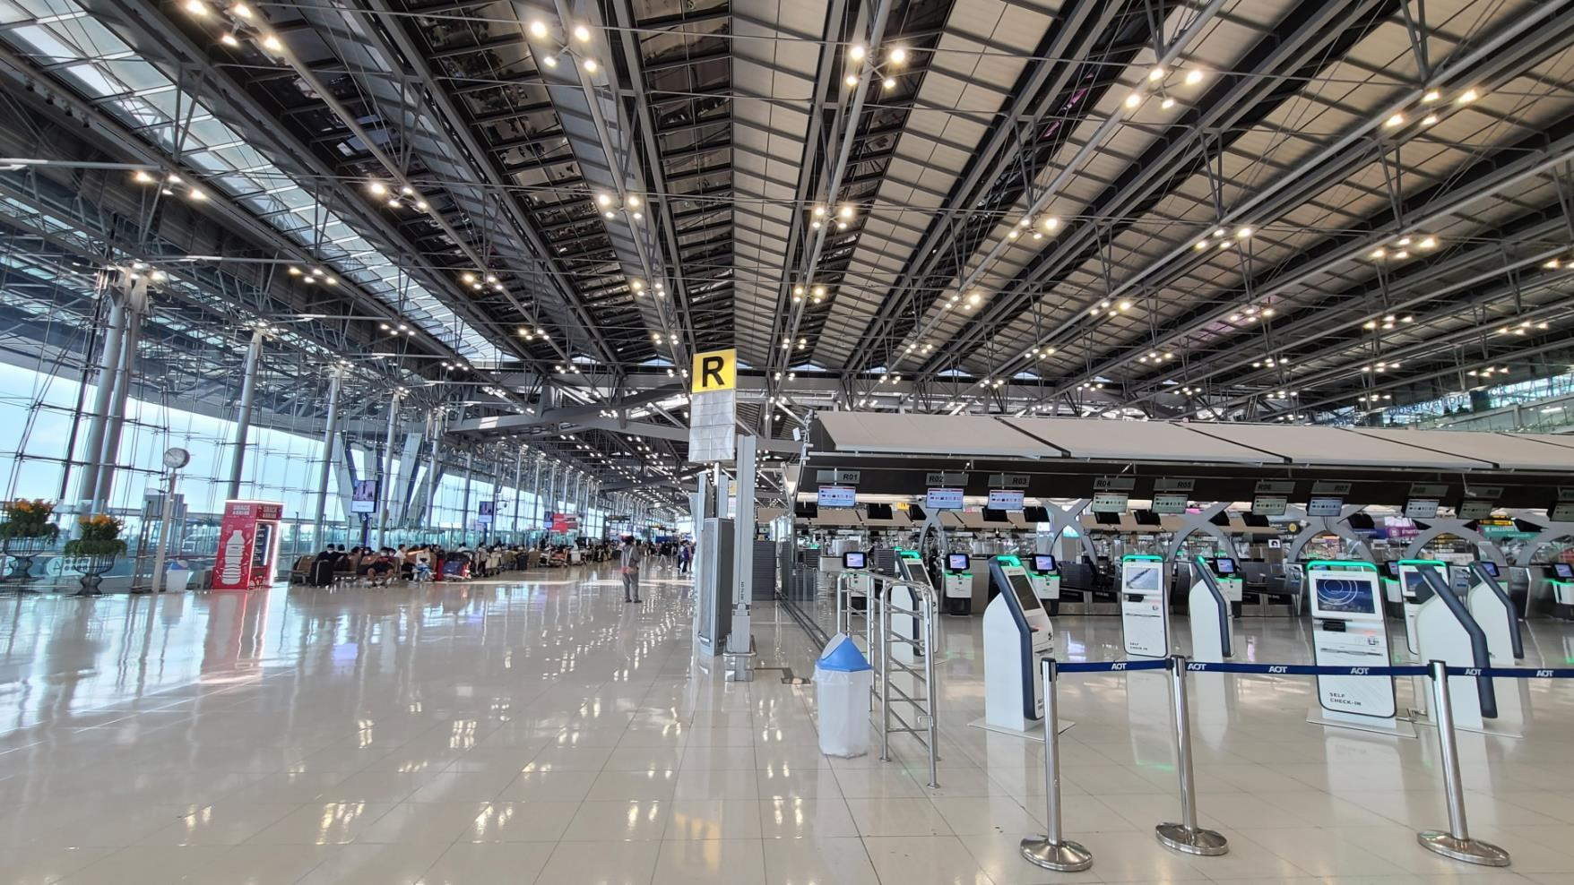
Day3 Move to Nagano
From Nagano, travel northwest by train and bullet train (Shinkansen).
Shinkansen bullet trains are the fastest and most convenient way of discovering Japan. The Japan Rail (JR) network is extensive and the trains reach a top speed of 320 km/h (199mp/h). This allows you to get to wherever you need in little time. Tokyo >Nagano top speed of 260km/h
Day2 Arriving Japan(Fukuoka Airport)
Your guide will pick you up at the Fukuoka airport.
On this day, we will guide you to a hotel in Fukuoka.
Enjoy Fukuoka Night on your first day in Japan

Slide 5
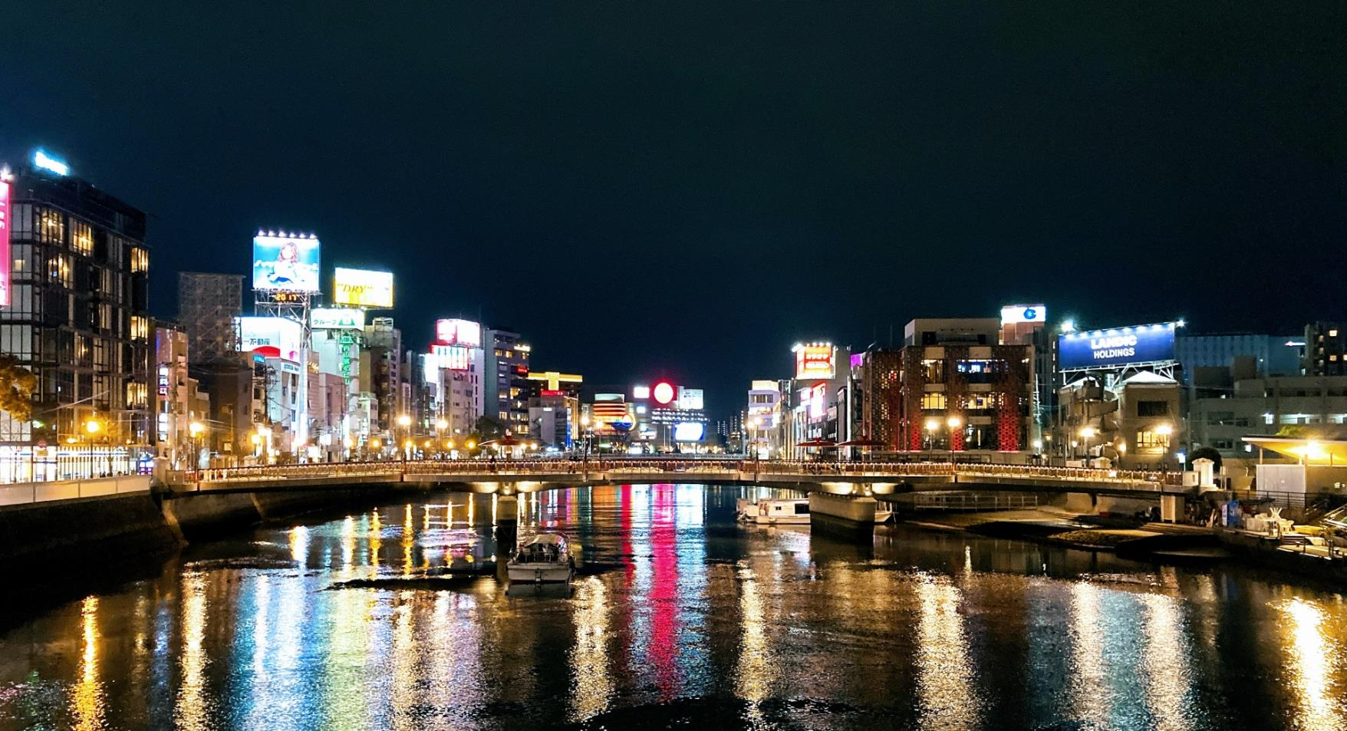
Day2 Fukuoka City
Stay overnight in Fukuoka on the day of arrival. Enjoy the first night in Nakasu, Kyushu's busiest district. One of Fukuoka's specialties is that when it gets dark, food stalls pop up all over the city.

Slide 6
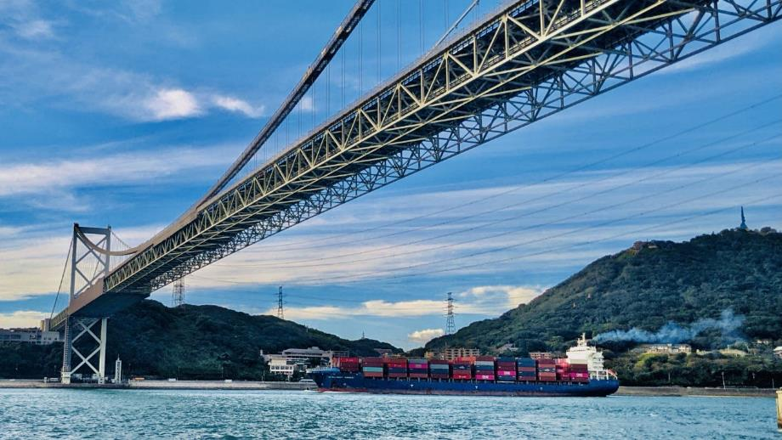
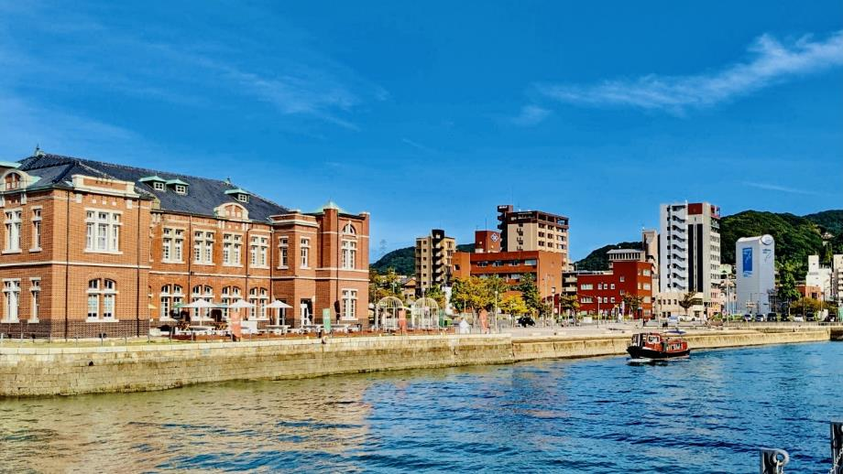
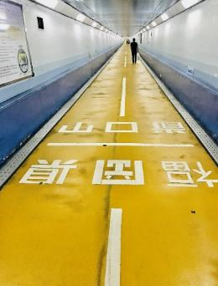
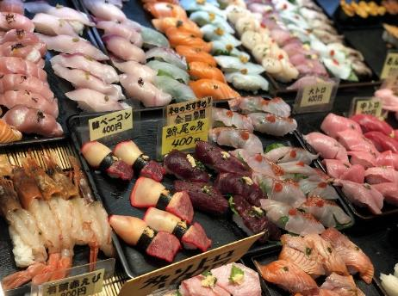
Day3 Fukuoka to Beppu Onsen
via Moji&Shimonoseki
Depart from Fukuoka and start your Japan trip. Take the Shinkansen to Moji in 30 minutes. This is the place where Kyushu and Shikoku are connected by bridges and underpasses. Cycling from Fukuoka to Shimonoseki by underpasses is fun experience.
At the Karato market in Shimonoseki, you can try a blowfish sushi.

Slide 7
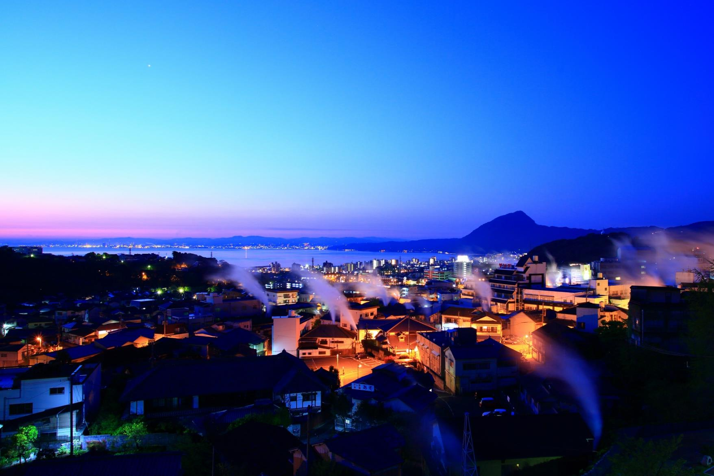
Beppu Onsen(Hot spring)
One of Japan's leading hot spring resorts. There are eight hot springs called Beppu Hatto, and steam rises from everywhere in the city. We will also visit a sightseeing spot called Jigoku Meguri(The hell tour).

Slide 8
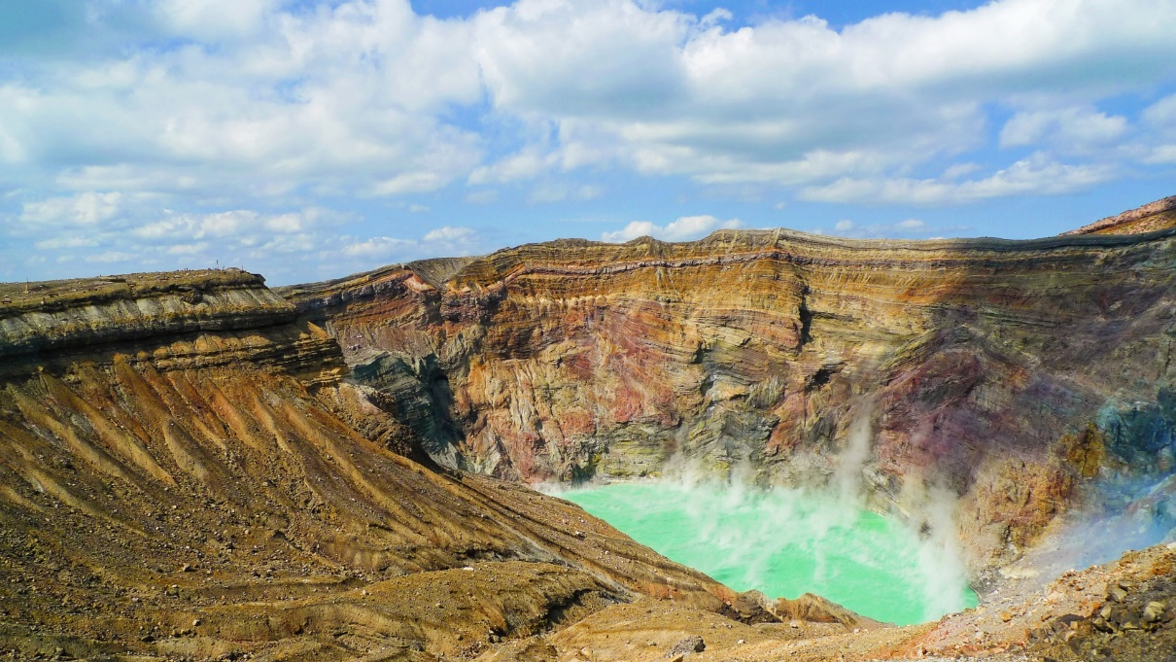
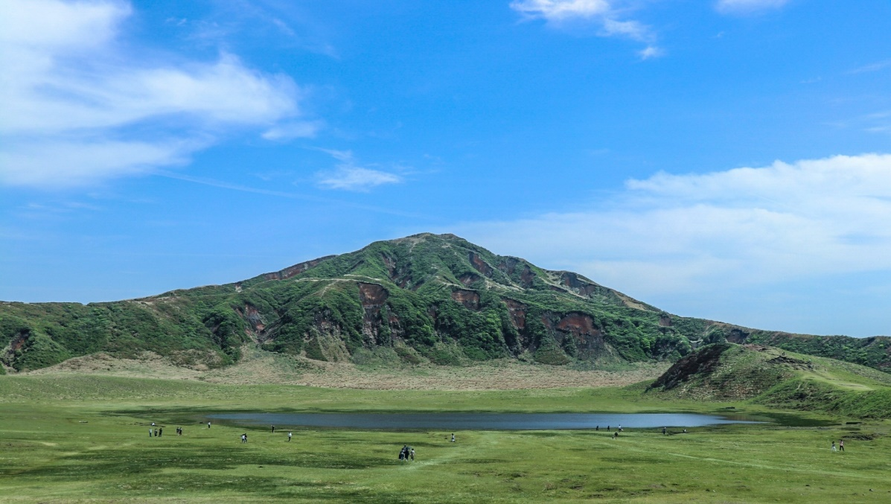
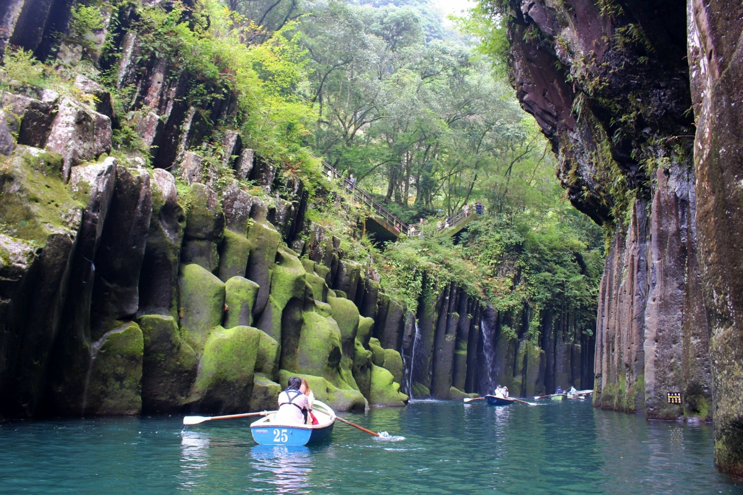
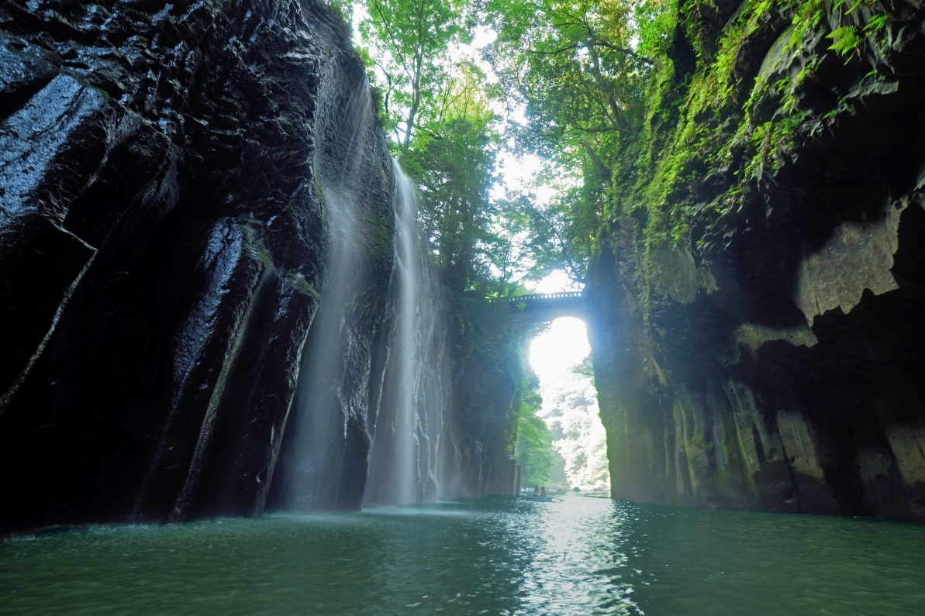
Day Day4 Beppu to Mt.Aso&Takachiho vally
Mount Aso is an active volcano and is the symbol of Kumamoto, which recently erupted in 2021.
Takachiho Gorge is a V-shaped gorge with 80-100m high cliffs that stretch for 7km.
A sightseeing spot that represents Miyazaki and is designated as a national natural monument.

Slide 9
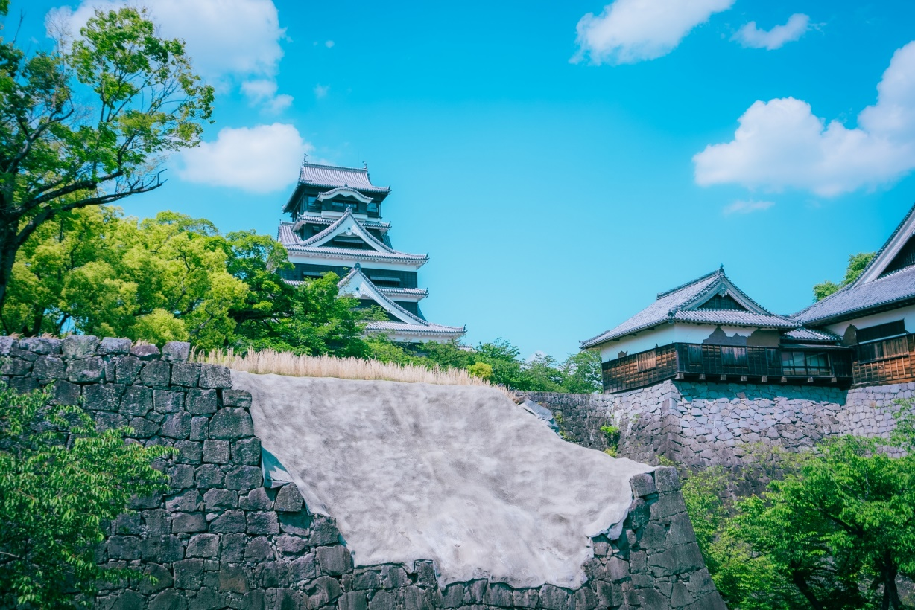
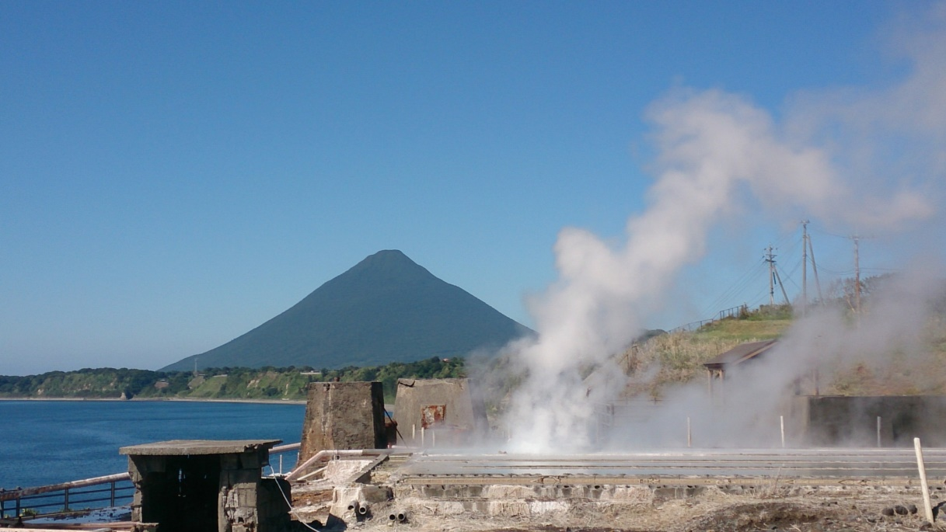
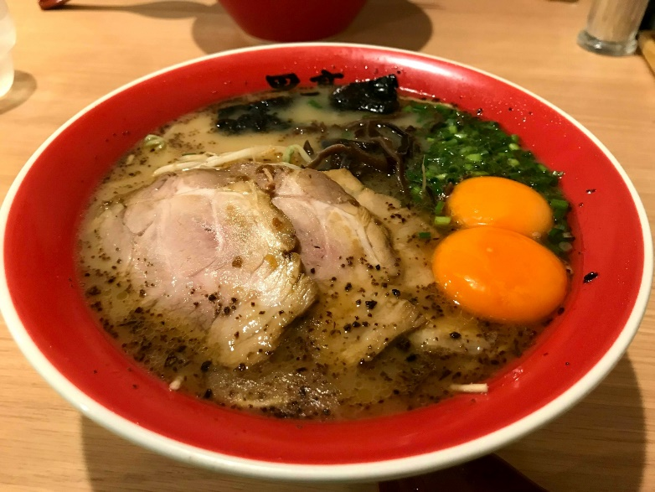
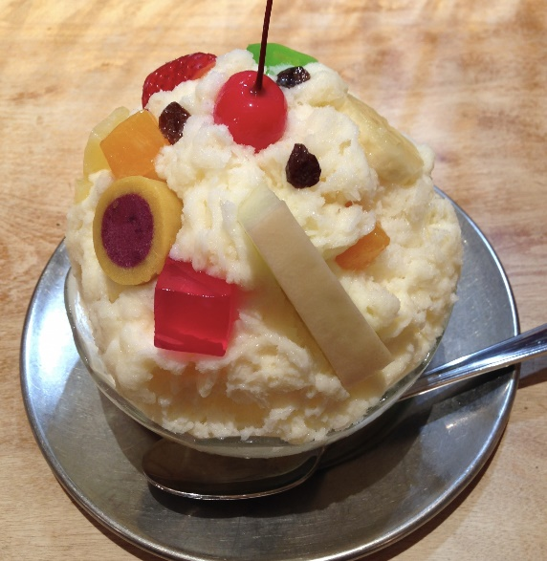
Day5 Kagoshima＆
Ibusuki Onsen(Hot Spring)
In Kagoshima, you will see the symbolic Sakurajima and stroll through Tenmonkan, a downtown area.
In Ibusuki, you can enjoy the famous "sand bath" and hot springs.
6月中旬まで

Slide 10
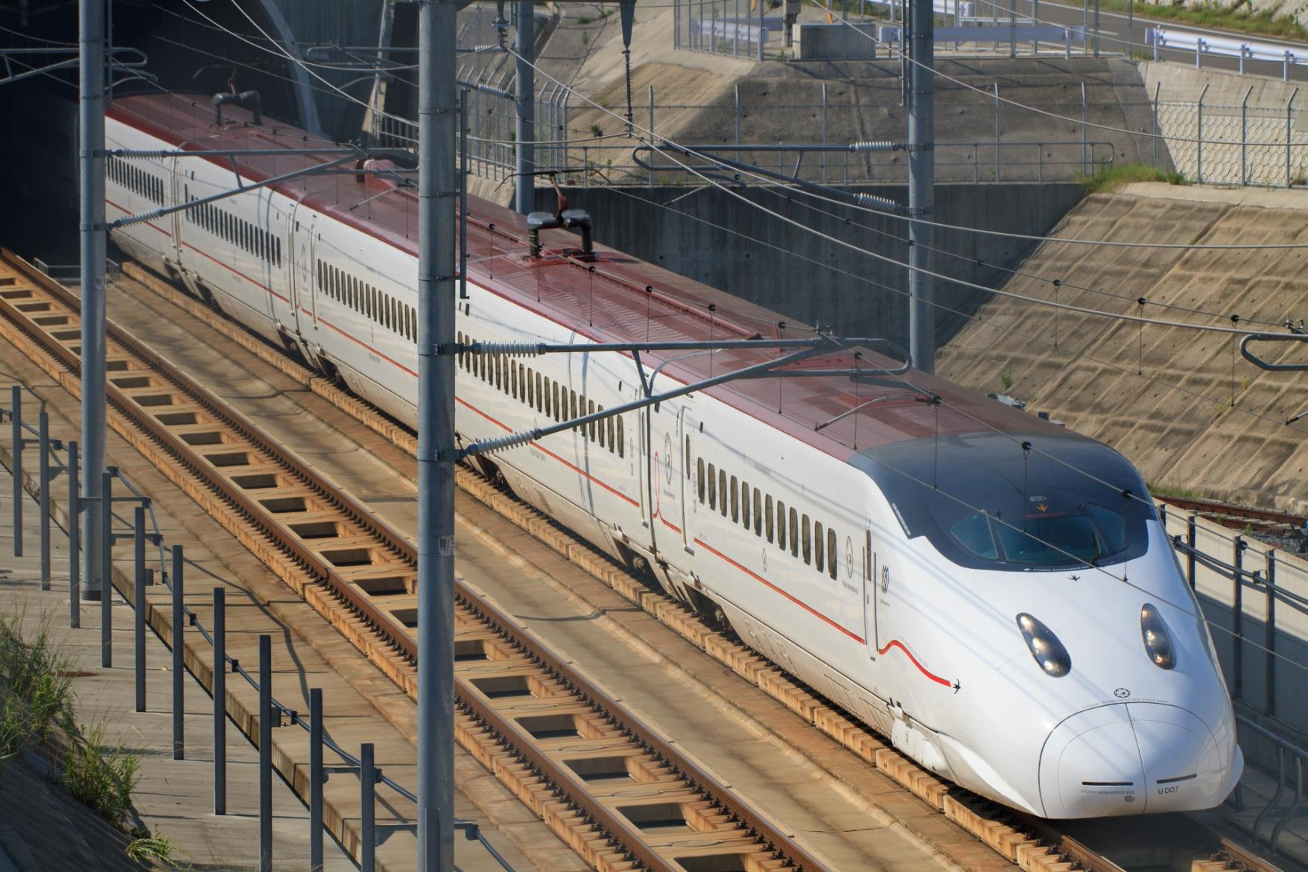
Day6 Move to Ureshino
From Ibusuki to Ureshino. travel Kyushu by train and bullet train (Shinkansen).
Shinkansen bullet trains are the fastest and most convenient way of discovering Japan. The Japan Rail (JR) network is extensive and the trains reach a top speed of 320 km/h (199mp/h). This allows you to get to wherever you need in little time.

Slide 11
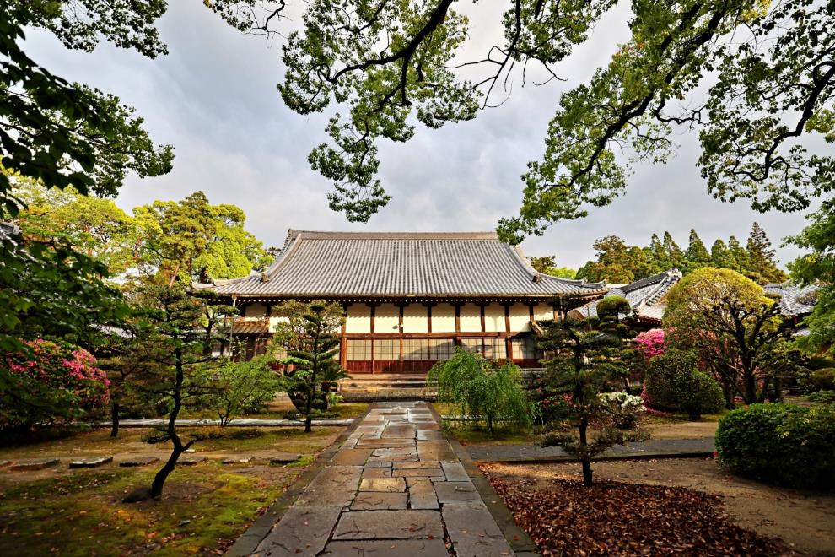
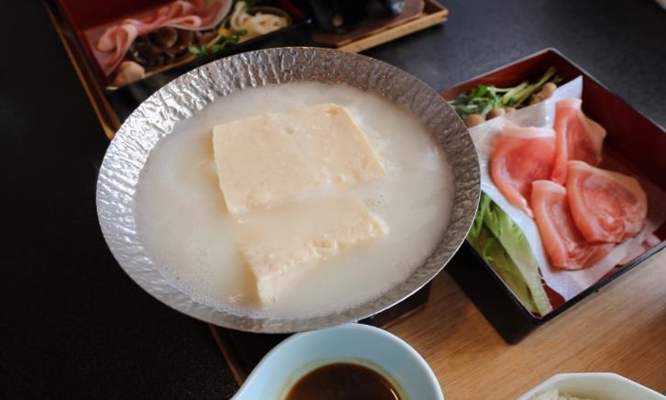
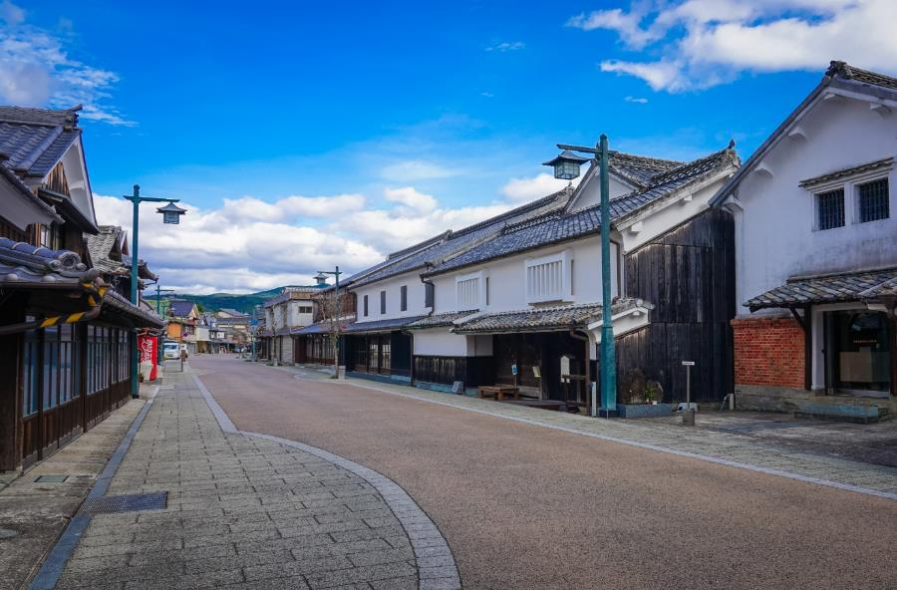
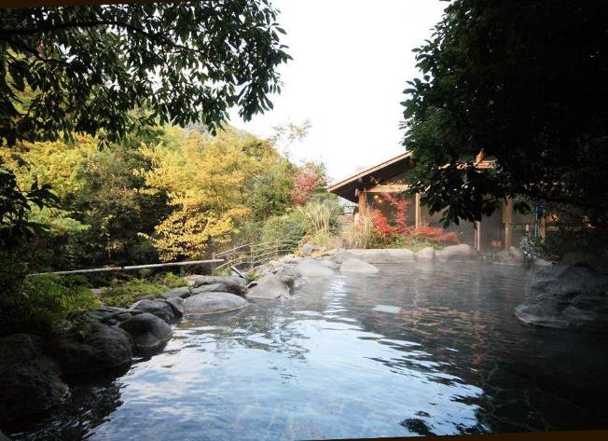
Day6 Uresino Onsen(Hotspring)
This hot spring area is so popular that it has been selected as one of Japan's top three hot springs for beautiful skin. Tourists come from all over Japan, but it is especially popular with women. There are many historical buildings in the city, and you can feel the history of hot springs. Yudofu(Simmered tofu) made with hot spring water is popular.

Slide 12
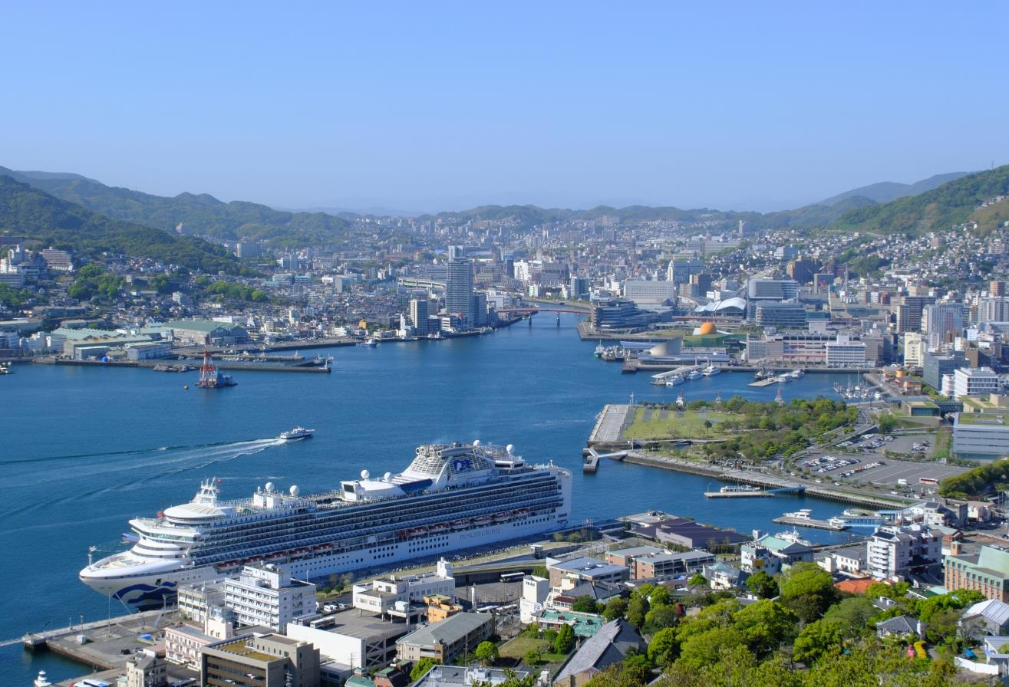
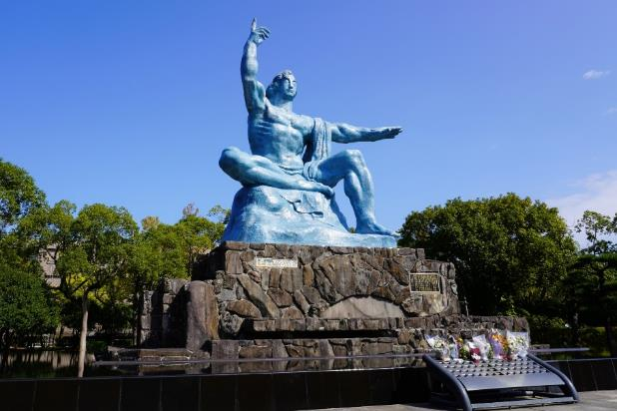
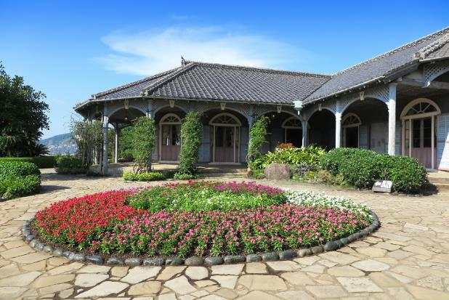
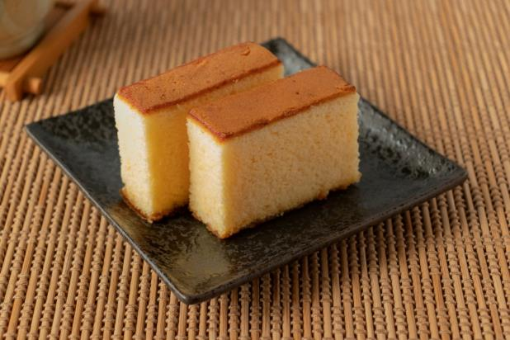
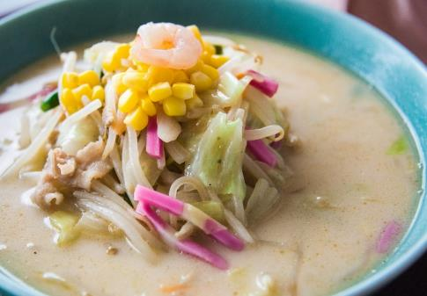
Day7 Nagasaki City
Nagasaki is located in the northwest of Kyushu and is a scenic land surrounded by the sea. There are many sightseeing spots such as the Glover House, Oura Cathedral, and Peace Memorial Park. You can also enjoy many dishes unique to Nagasaki, such as Nagasaki champon, castella, and Turkish rice.

Slide 13
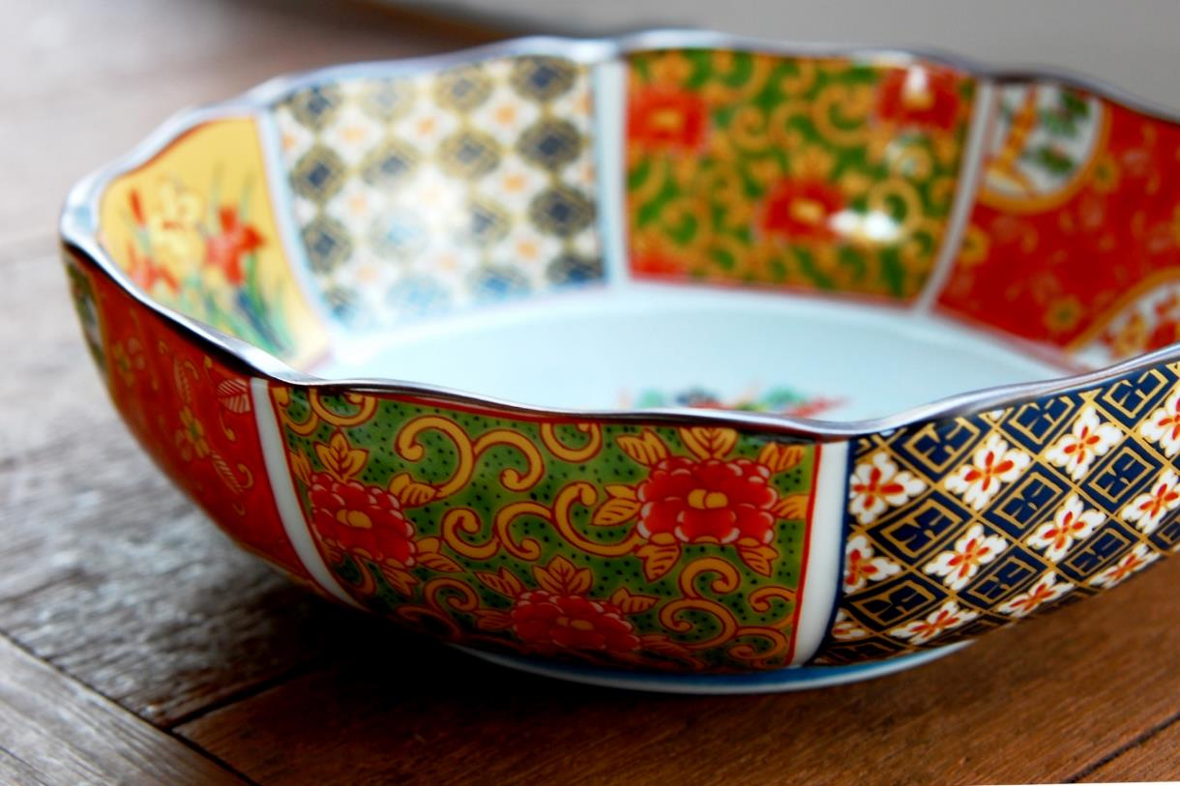
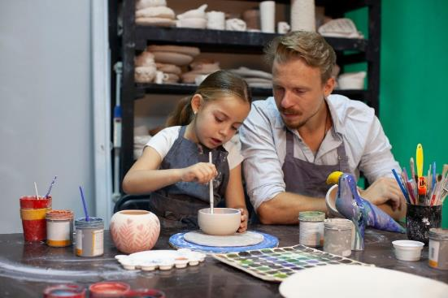
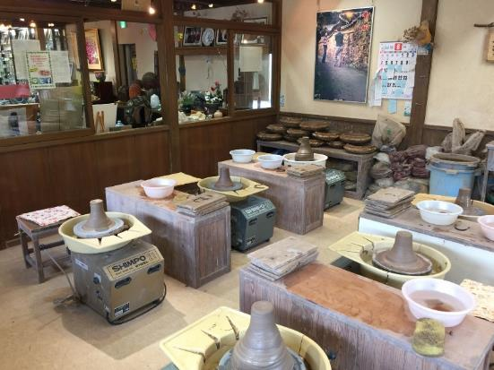
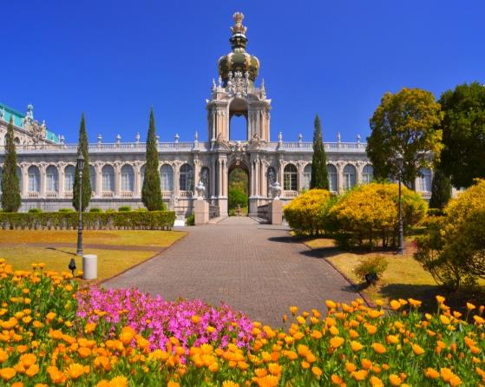
Day 8 Imari(Arita) Ware Experience
Arita-yaki is also called Imari-yaki because it was shipped from the port of Imari. We will make tea bowls on a potter's wheel and paints coffee cups. We create our own original works. The goods will be sent by sea freight at a later date.
After this wonderful experience, we will return to Fukuoka for the first time in a week.

Slide 14
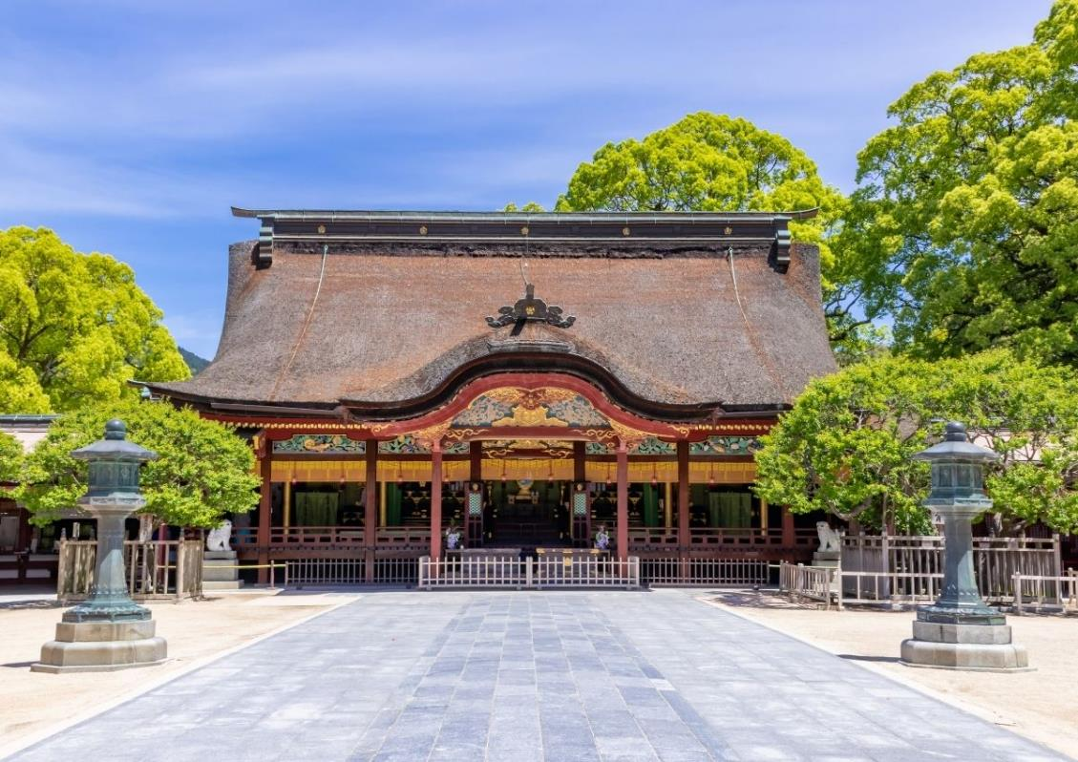
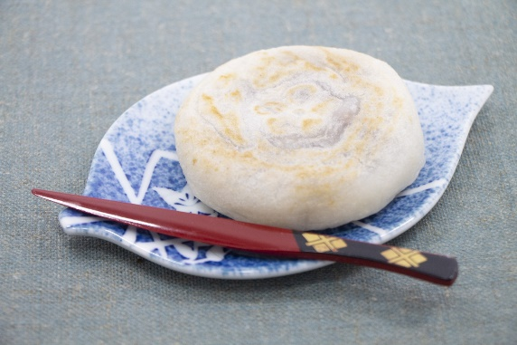
Day9 Dazaifu Tenmangu Shrine
On the morning of the final day, head to Dazaifu Tenmangu Shrine, Fukuoka's number one tourist destination. Known as the god of learning, more than 8.5 million people visit every year. Umegae mochi is famous and sold at many shops along the approach. In the afternoon, free time to go to Fukuoka Airport in the evening.

Slide 15
Back to Hawaii
With wonderful memories in Japan to hawaii
See you again in Japan!

Slide 16
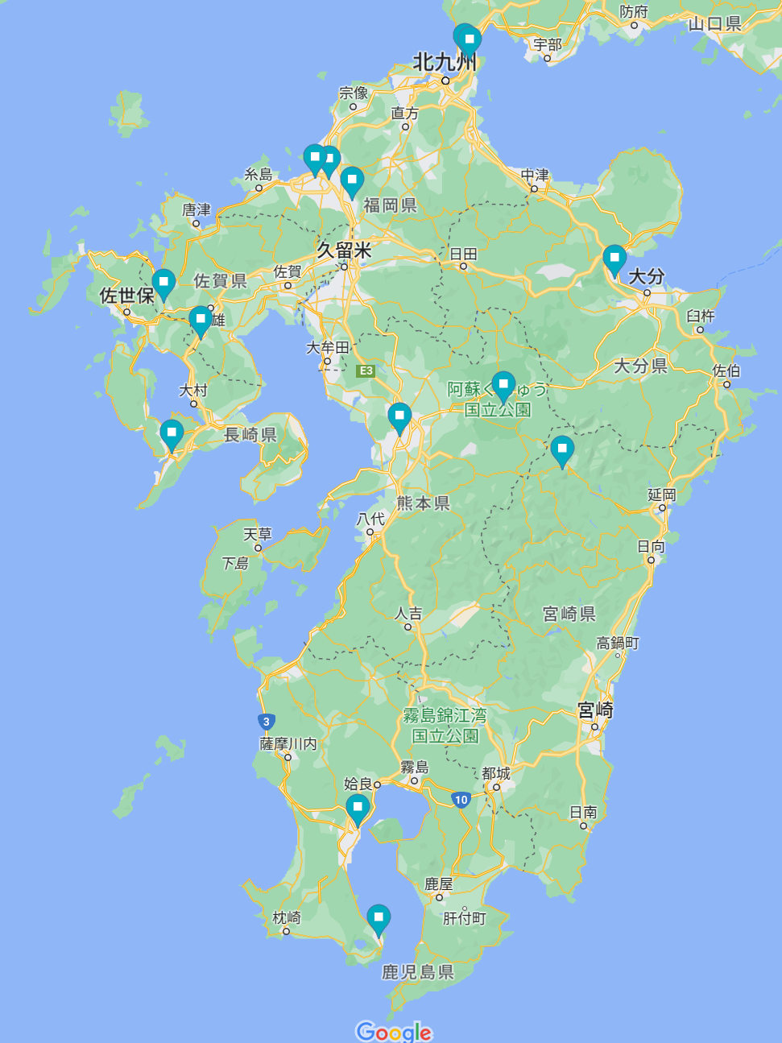
Kyushu Round Trip

