Slide 1
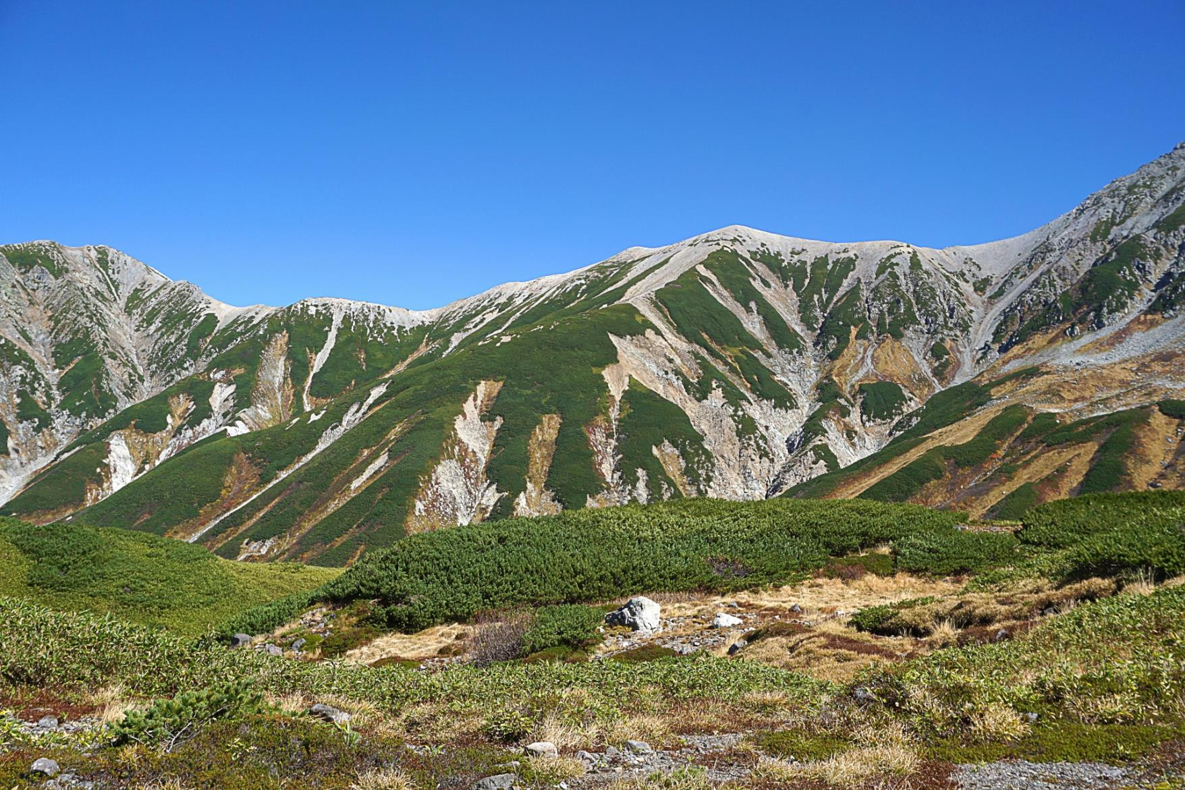
2024 Hokuriku Area Trip
10 days trip
to enjoy the countryside and nature of Japan
～

Slide 2
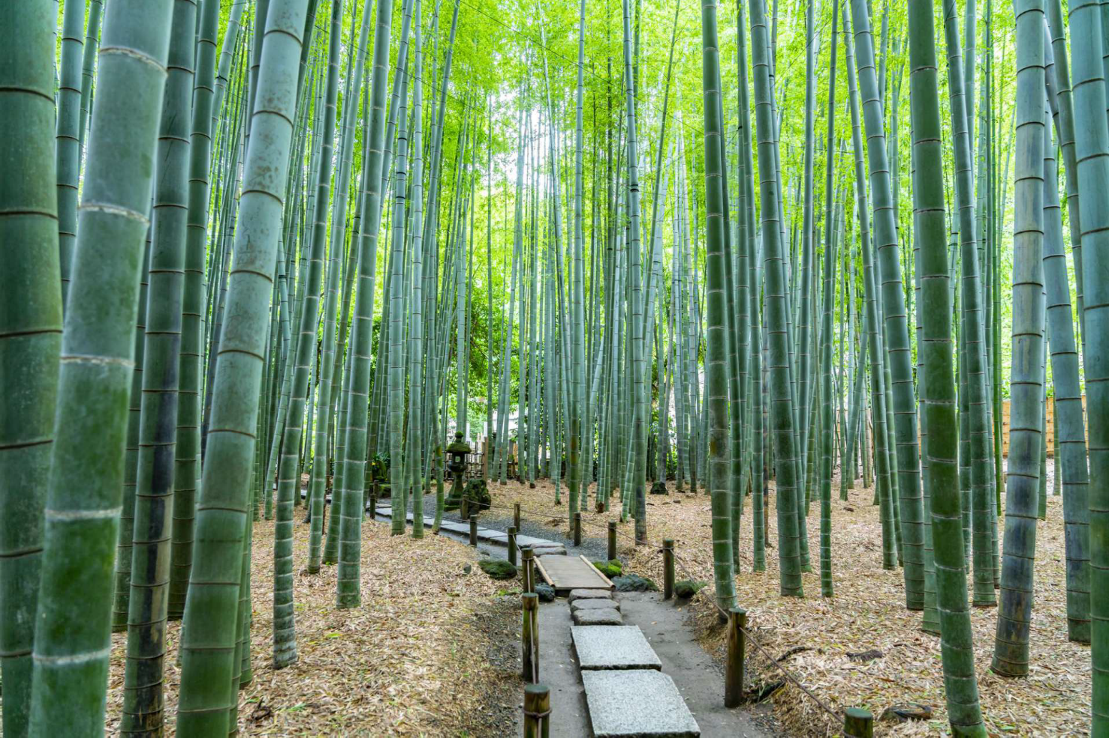
Thank you for your enquiry about Japan Travel
I have prepared an original itinerary for touching and feeling “real Japan”.
You can't understand the real Japan just by traveling like only Tokyo and Kyoto.
Scenery you've never seen in Hawaii.
Food you have never eaten before.
Incredible warm people.
“Real Japan” is in country side!
We will prepare a schedule for you to enjoy the best of Japan and a dedicated guide full of hospitality. By all means, we recommend a “Inaka Tabi(country trip)” for your second trip to Japan.
We will do our best to accommodate any arrangement.
Sawakami Tours

Slide 3
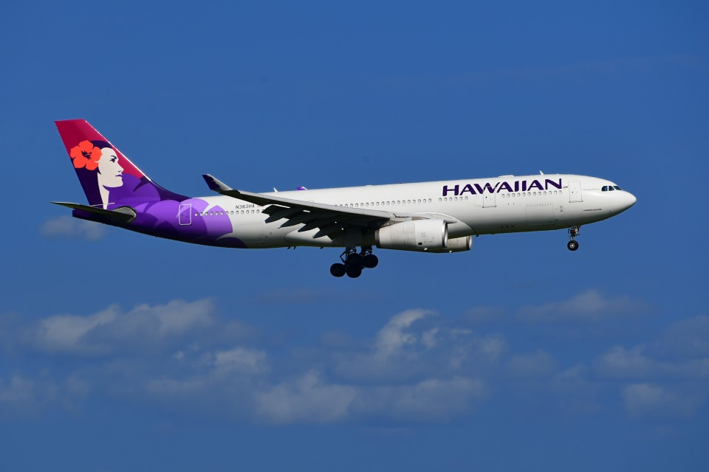
Day1 Hawaii to Japan(Narita or Haneda)
Day2 Arriving Japan
Leaving Hawaii to Japan!
On this trip, “Special memories of Japan just for you”
I hope you can make it!

Slide 4
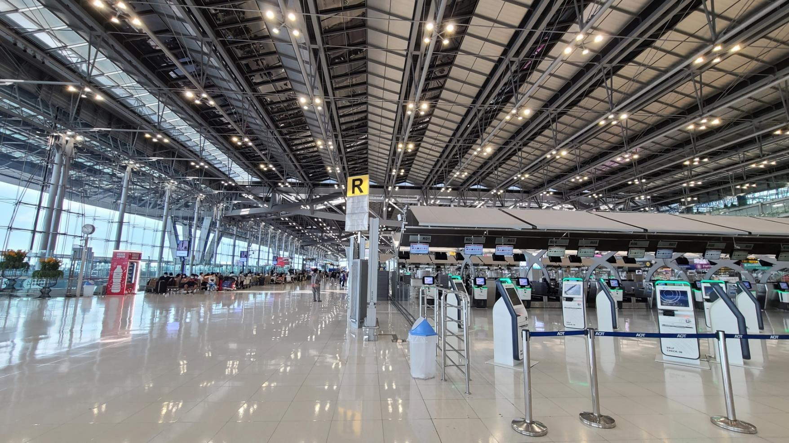
Day3 Move to Nagano
From Nagano, travel northwest by train and bullet train (Shinkansen).
Shinkansen bullet trains are the fastest and most convenient way of discovering Japan. The Japan Rail (JR) network is extensive and the trains reach a top speed of 320 km/h (199mp/h). This allows you to get to wherever you need in little time. Tokyo >Nagano top speed of 260km/h
Day2 Arriving Japan
Your guide will pick you up at the airport. On this day, we will guide you to a hotel in Tokyo. Enjoy Tokyo Night on your first day in Japan

Slide 5
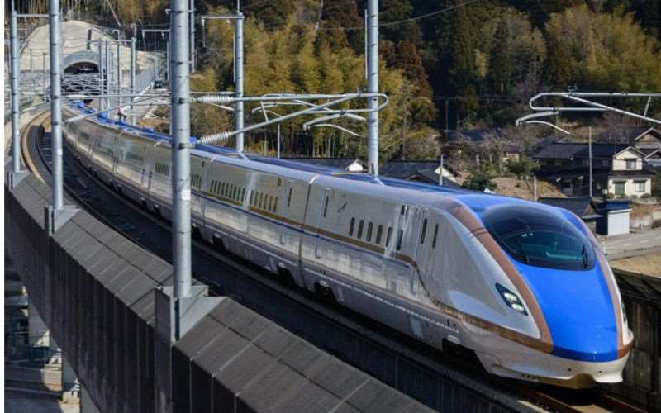
Day3 Move to Nagano
From Nagano, travel northwest by train and bullet train (Shinkansen).
Shinkansen bullet trains are the fastest and most convenient way of discovering Japan. The Japan Rail (JR) network is extensive and the trains reach a top speed of 320 km/h (199mp/h). This allows you to get to wherever you need in little time. Tokyo >Nagano top speed of 260km/h

Slide 6
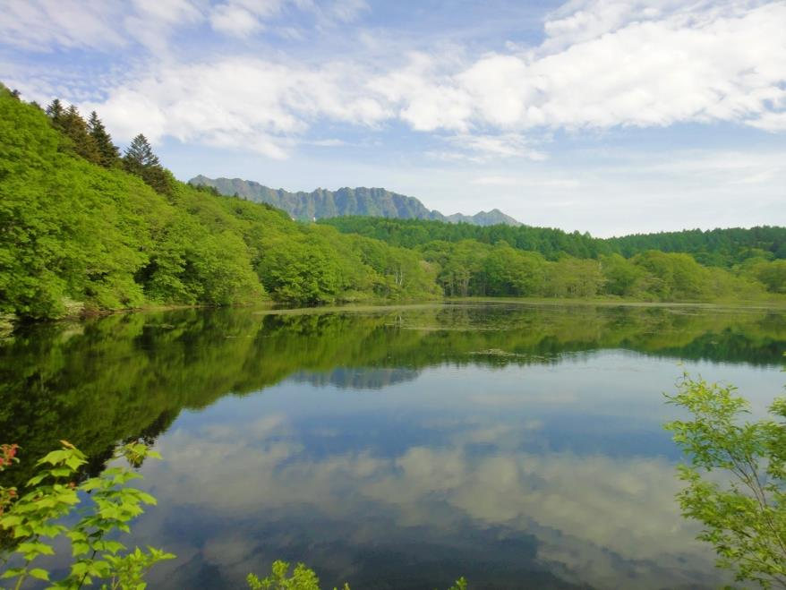
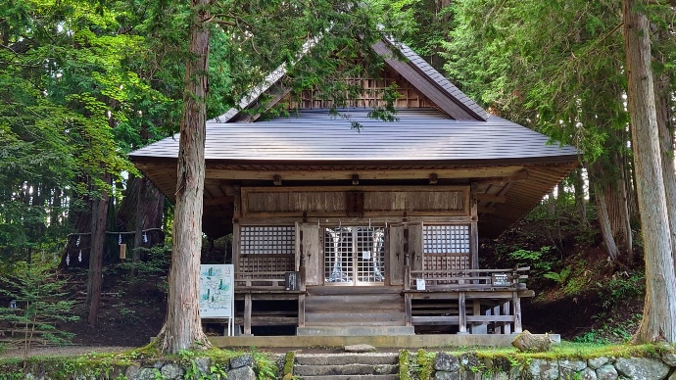
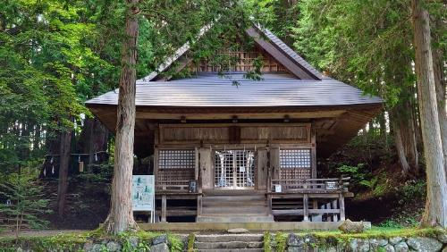
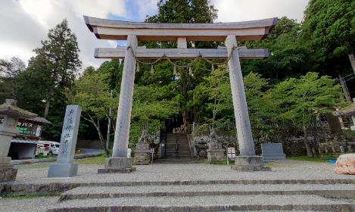
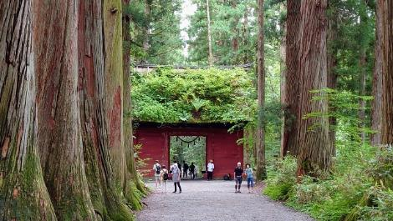
Day3 Tokyo to Nagano
We leave Tokyo and begin our trip to Japan. The first destination is Nagano Prefecture, which is less than two hours from Tokyo by Shinkansen.
Nagano Prefecture is located almost in the center of Japan and is surrounded by mountains. There are 3000m class mountains such as the Northern Alps and Southern Alps, and it is crowded with many climbers in the summer.
It prospered as an important highway in Edo period , many castle towns and post towns were built. It is a prefecture where you can enjoy both nature and history.
On this day, we hiked around Togakushi Shrine, which is located at the foot of Mt. Then, visit Zenkoji, a temple that represents Nagano Prefecture.

Slide 7
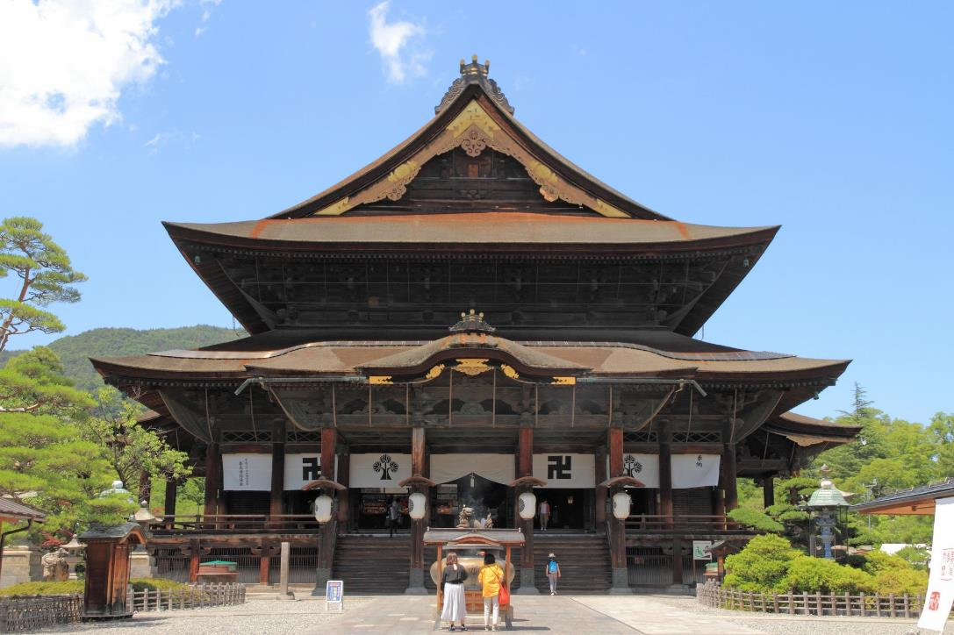
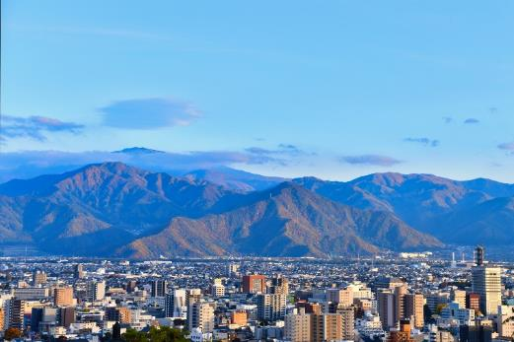
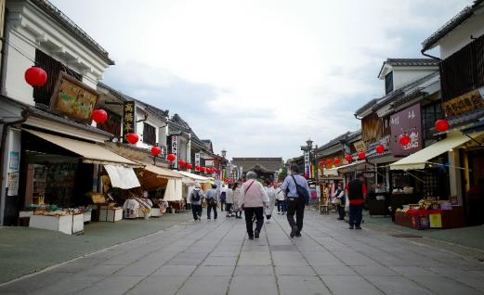
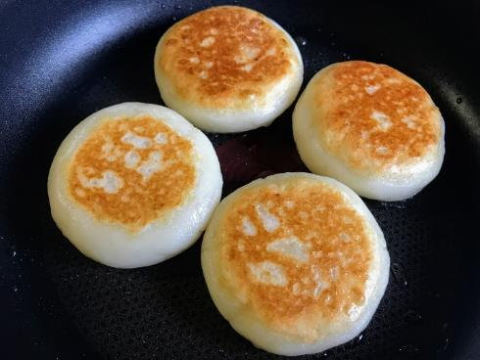
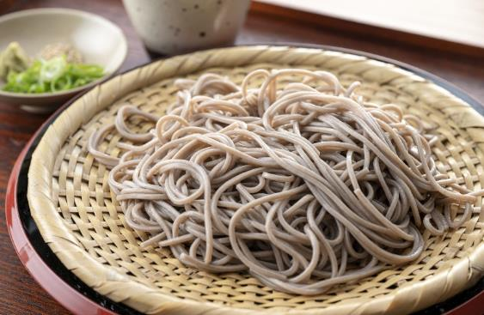
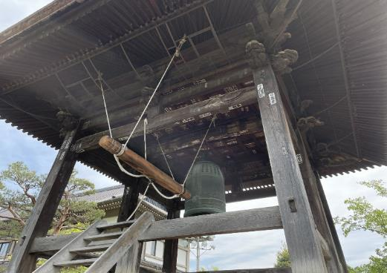

Slide 8
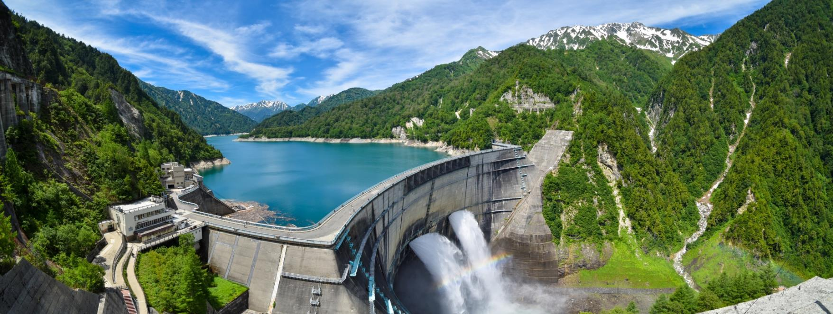
Day 4 Alpen Route
Today we will explore the Alpine Route. Cross the Japanese Alps from Nagano to Toyama using 8 modes of transportation. The highest point is Murodo with an altitude of 2450m. The Kurobe Dam, which took 7 years and great sacrifices to complete, is a masterpiece!
Until mid-June, you can see a wall of snow several meters high.

Slide 9
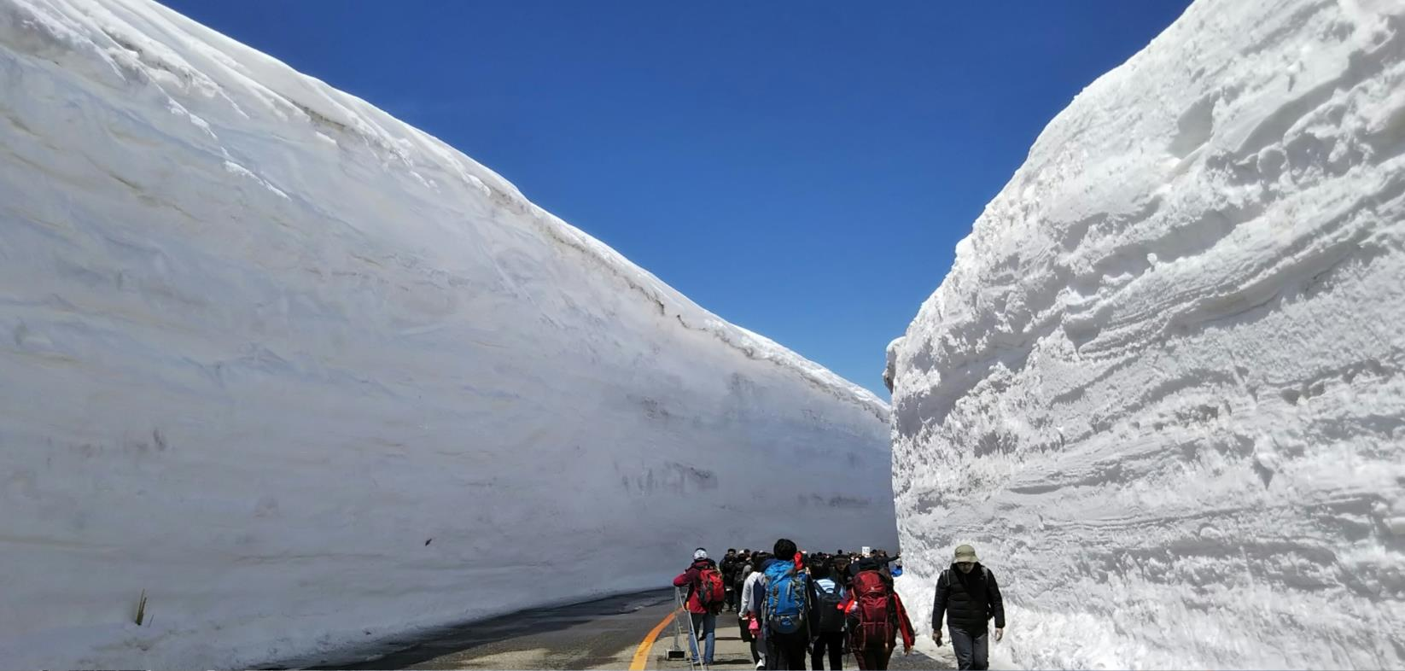
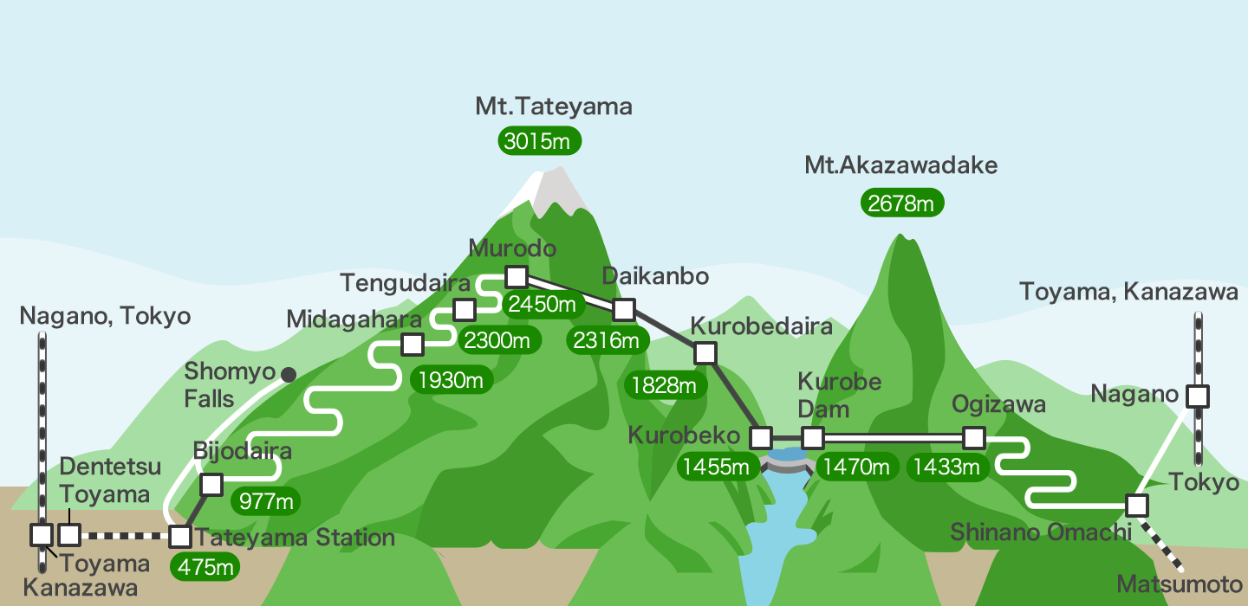
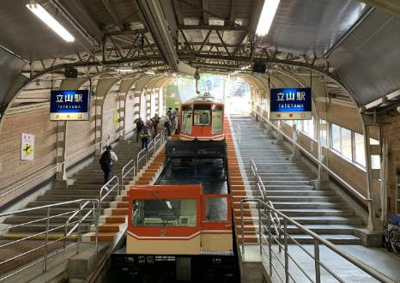
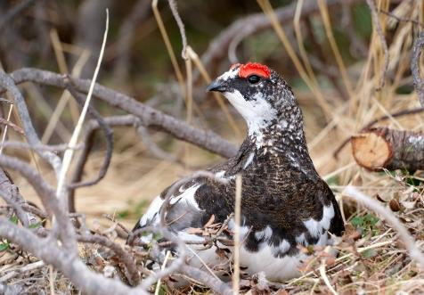
Until Mid June

Slide 10
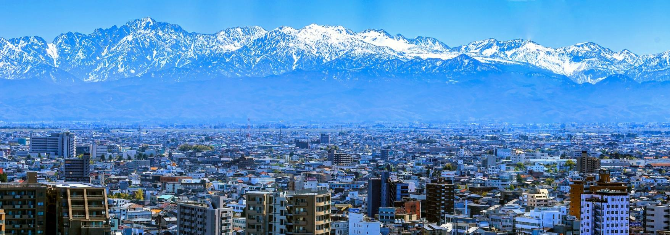
Day 5 Toyama to Shirakawago
Toyama Prefecture faces the Sea of Japan and has a population of one million. You can see the beautiful Tateyama mountain range from Toyama city. It is also famous for sushi made with fresh seafood from the Sea of Japan, and you can eat cheap and delicious sushi here.
World Heritage Site Shirakawa-go is located in Gifu Prefecture and is famous for its gassho-style buildings. We stayed at this world heritage site this time.

Slide 11
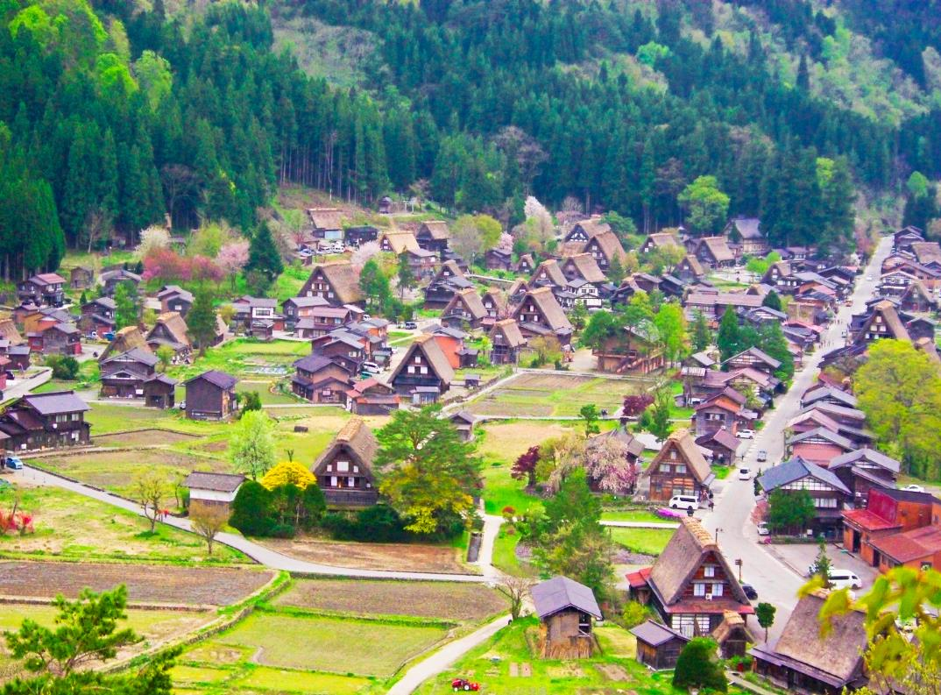
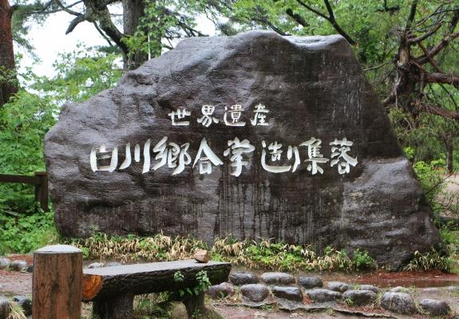
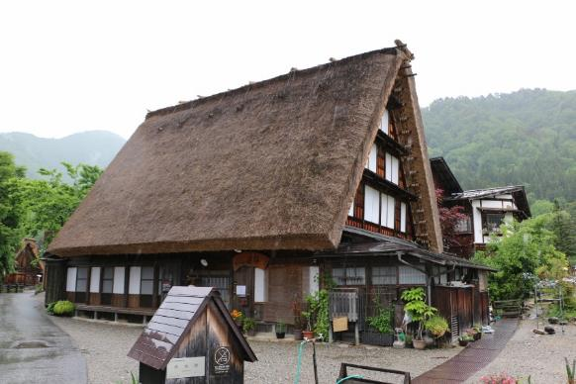
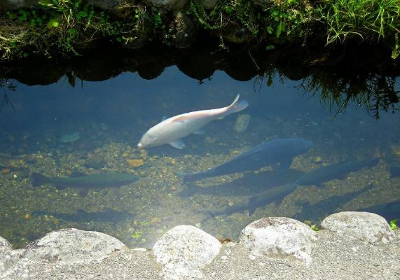
Shirakawago/The World Heritage
Shirakawa-go (Shirakawa Village) is a Japanese mountain settlement in what was once considered a wild and unexplored region. Because of the area’s natural environment, with high mountains and heavy snowfall, interaction with neighboring regions was limited. However, this also created the conditions for the development of unique cultural practices and lifestyles. Now registered as a World Cultural Heritage site, we hope that you will enjoy experiencing the culture and traditions that live on in Shirakawa-go today.

Slide 12
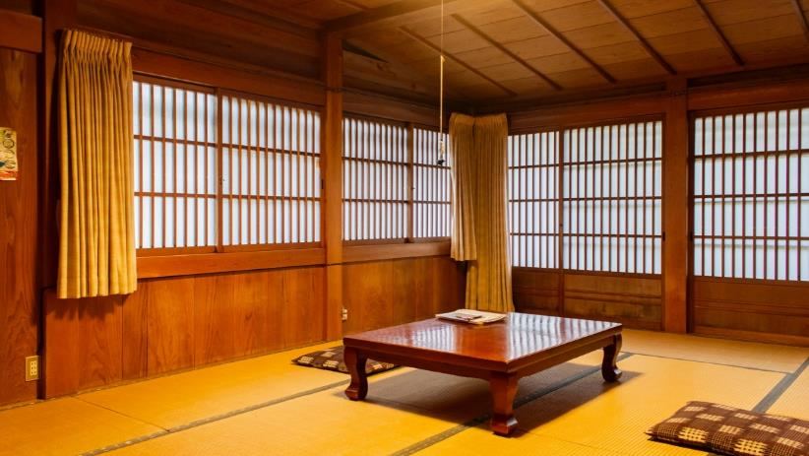
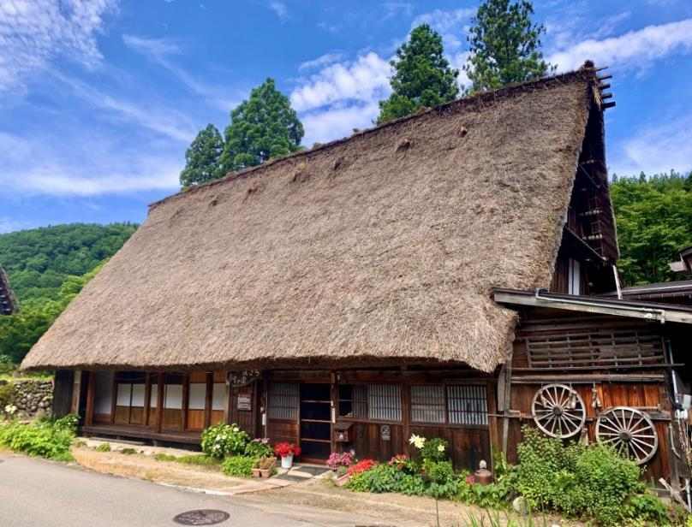
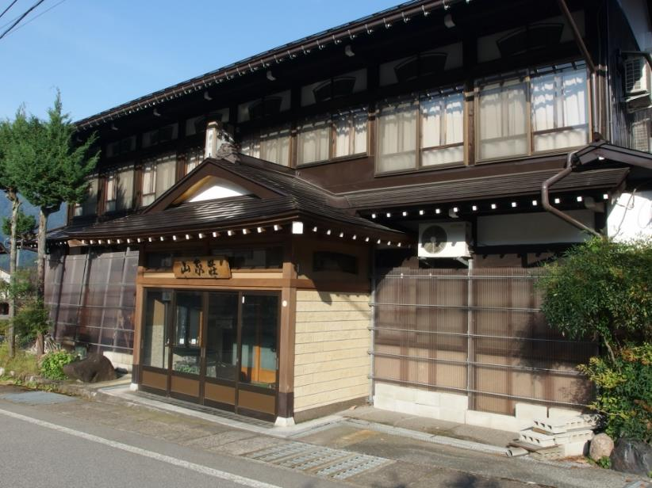
Minshuku style
In Shirakawa-go, you will stay at an inn called a minshuku, which is an old Japanese house. A minshuku is a style of lodging that is common in rural areas, where an empty room in a house is rented out as a lodging facility for travelers. This time we will stay at Minshuku style hotel in the Shirakawa-go area. By staying at a minshuku style hotel, you can experience the local life and the life of the Japanese countryside. *There are dozens of minshuku in Shirakawa-go, but you cannot specify a minshuku.

Slide 13
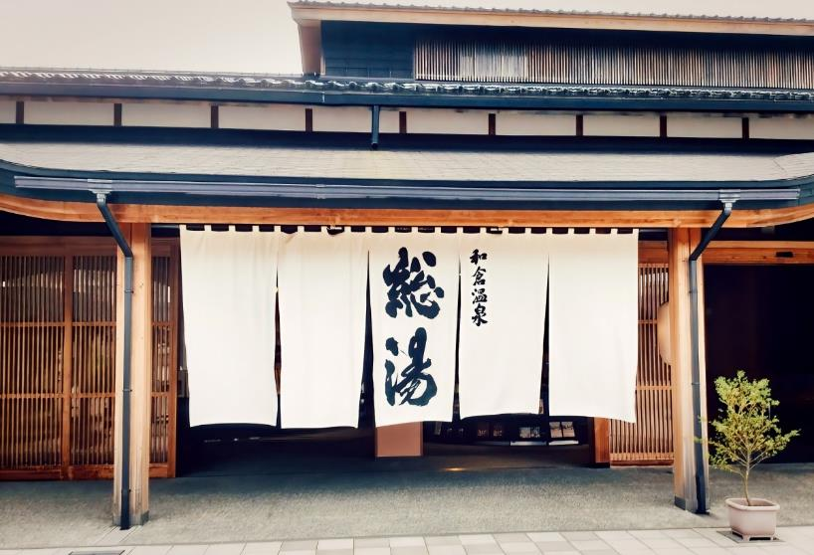
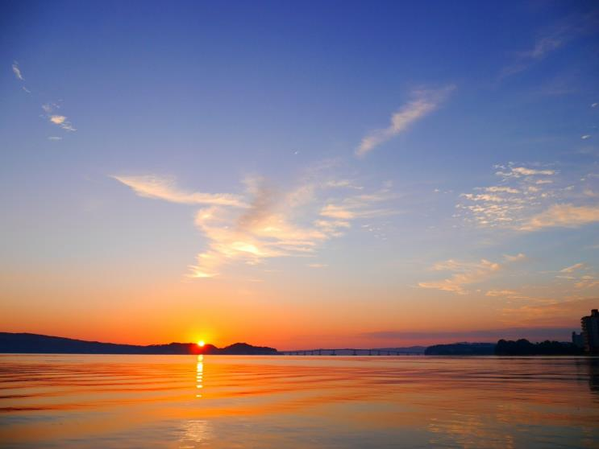
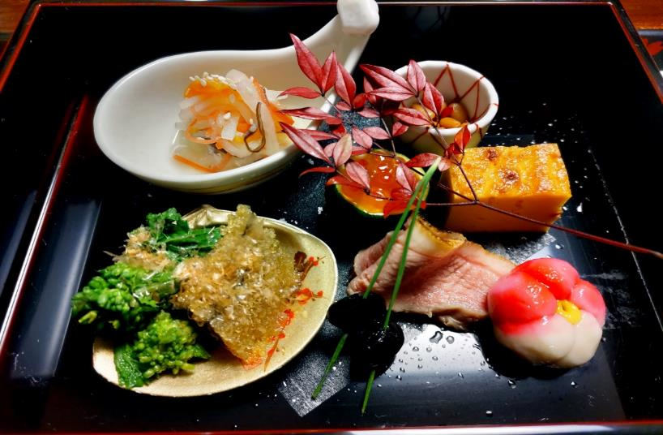
Day 6 Shirakawago to Wakura Onsen
From Shirakawa-go to Wakura Onsen in Ishikawa Prefecture via Kanazawa. Wakura Onsen is one of Japan's leading luxury hot spring resorts located in the middle of the Noto Peninsula.
There are many Ryokan facing Nanao Bay, where you can enjoy wonderful views and delicious seafood.

Slide 14
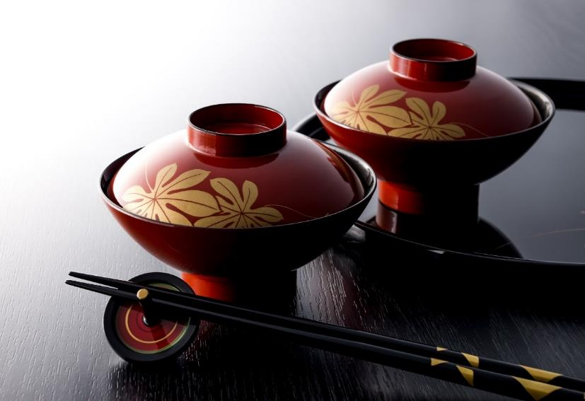
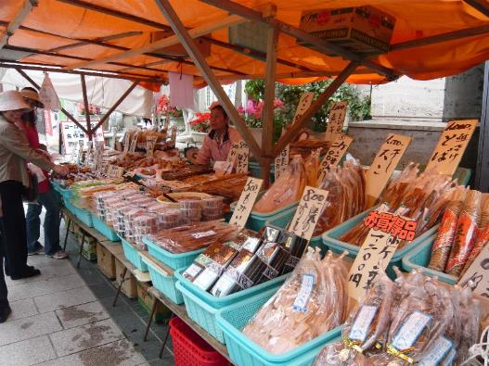
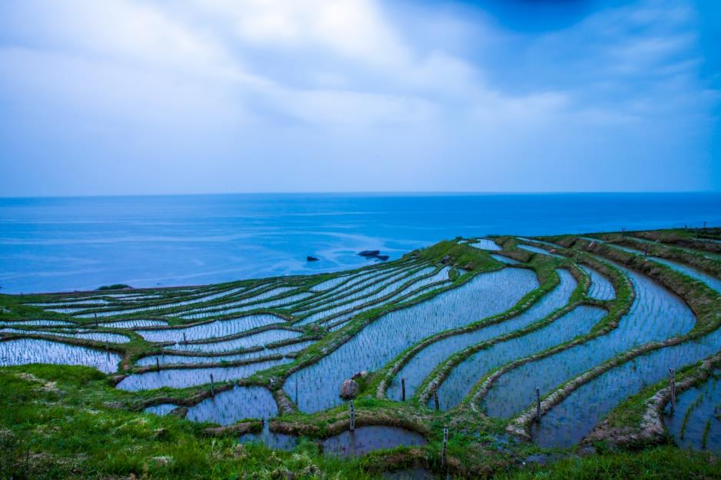
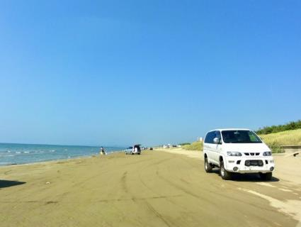
Day7 Noto Peninsula Sight Seeing
Take a taxi around the Noto Peninsula.
After shopping at the morning market in Wajima, stop by a Wajima lacquerware shop. After visiting Shiroyone Senmaida with small rice fields and Nagisa Driveway where you can drive along the beach, head to Kanazawa.

Slide 15
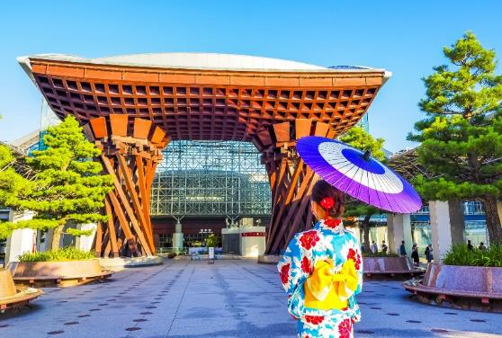
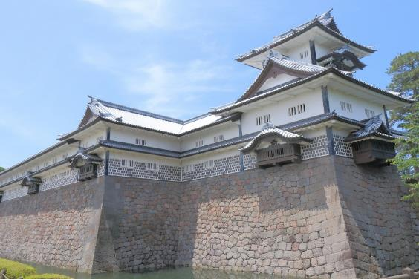
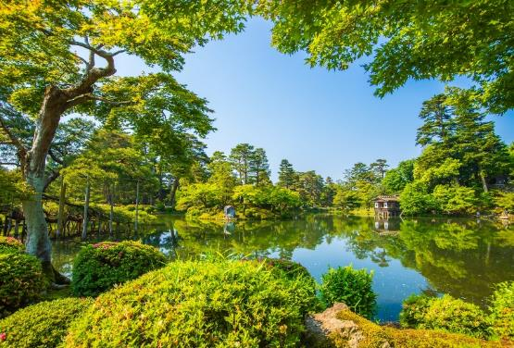
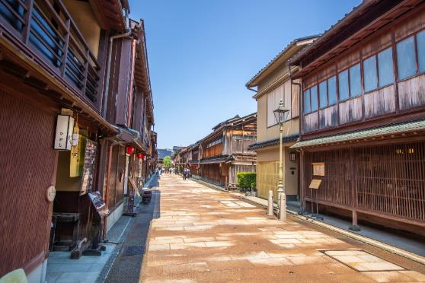
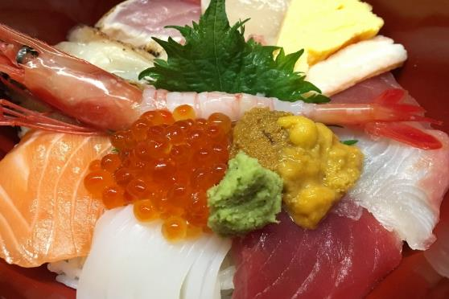
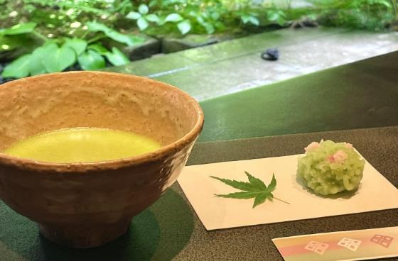
Day8 Kanazawa 1day Sight Seeing
Kanazawa is the center of Ishikawa Prefecture and the largest city in the Hokuriku region.In particular, since the Tokyo-Kanazawa Shinkansen section opened in 2015, it has become a popular travel destination for many tourists from Tokyo area.
Kanazawa is also known as Little Kyoto, and has historical townscapes and castles. Seafood is delicious, starting with Omi Market, and there are many restaurants that serve delicious sushi. Japanese sweets are also famous, and Japanese sweets and soft serve ice cream using gold leaf, which is a specialty, are also popular.

Slide 16
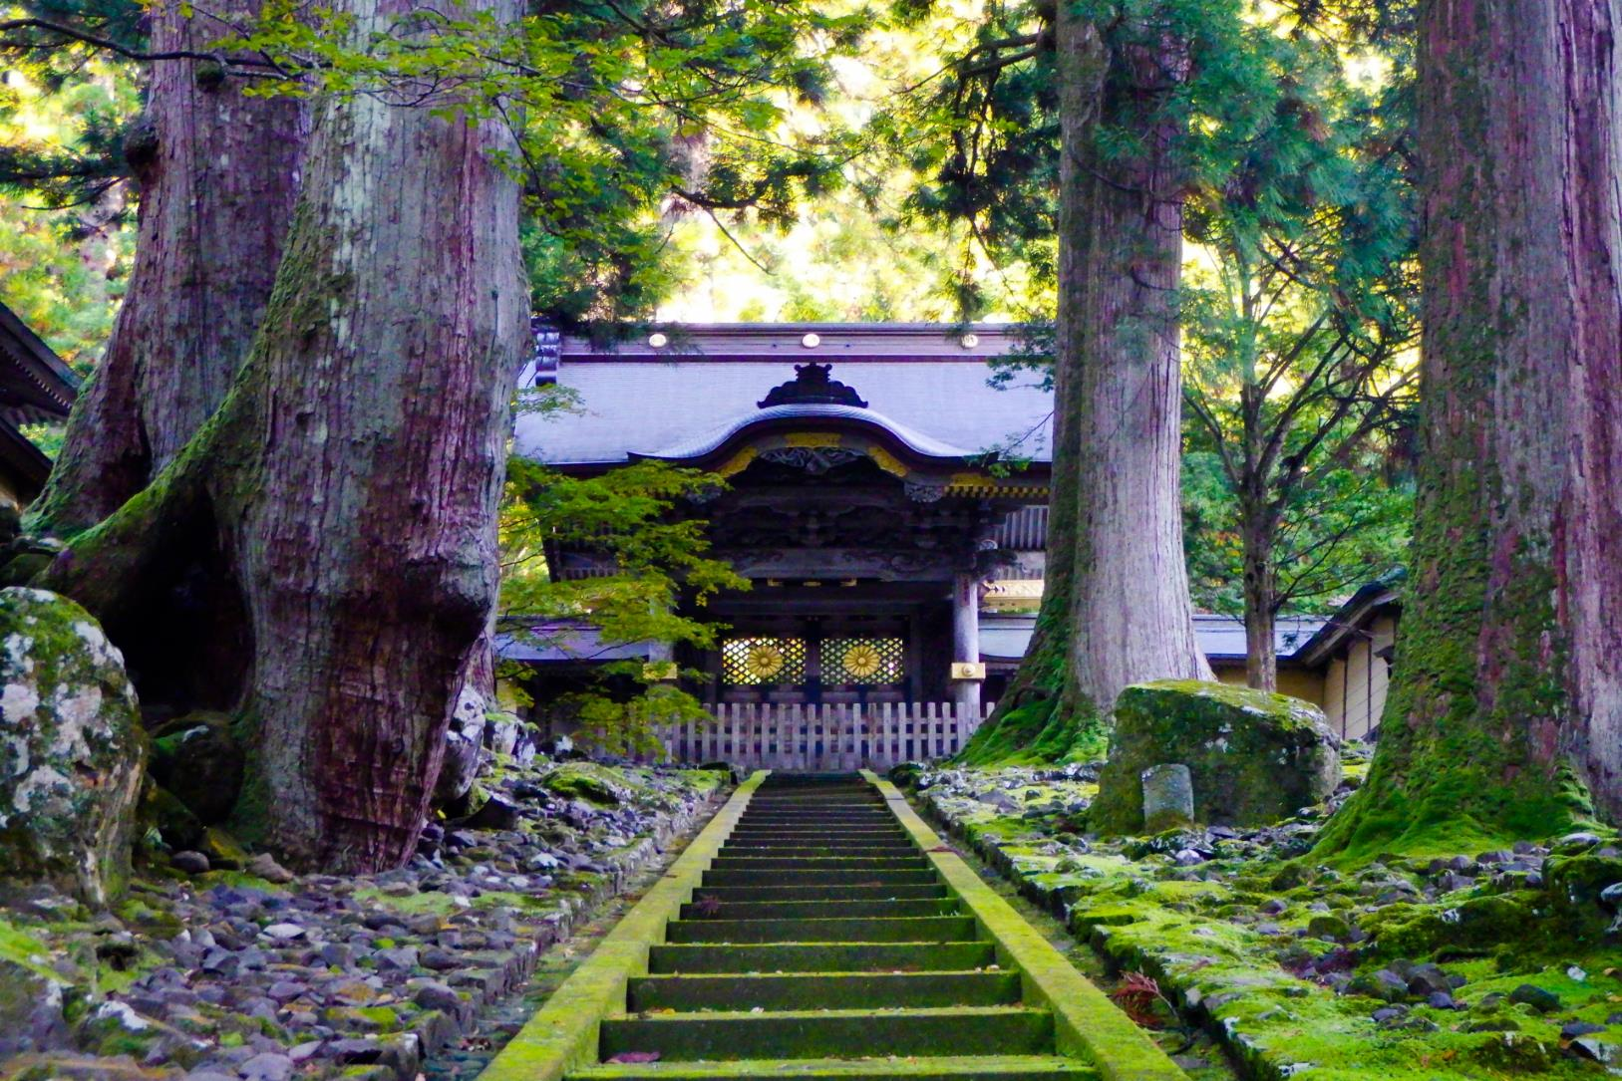
Day9 Eiheiji & Dinosaur Museum (Fukui Prefecture)
Eiheiji is the head temple of the Soto sect of Buddhism and is a Zen dojo that has inherited the history and tradition of over 700 years. Tourists interested in “Zen” visit from all over the world.
The Dinosaur Museum opened in its current location in 2013. It became popular as one of the world's three largest dinosaur museums. Dinosaur fossil excavation sites are also nearby, and excavation work is still going on today.

Slide 17
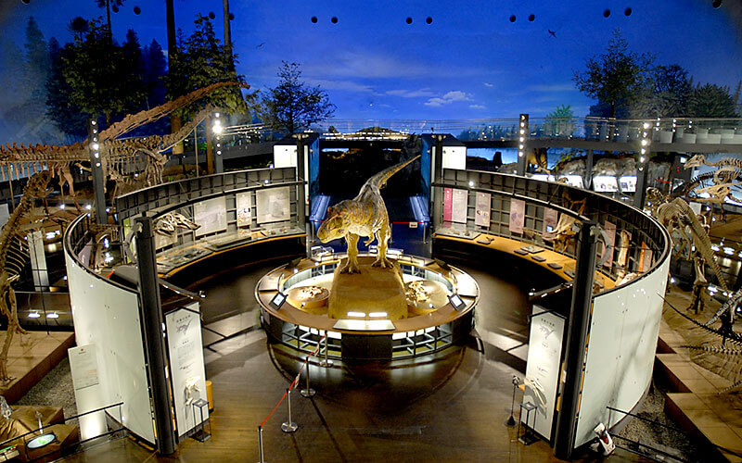
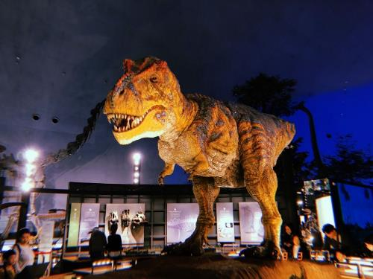
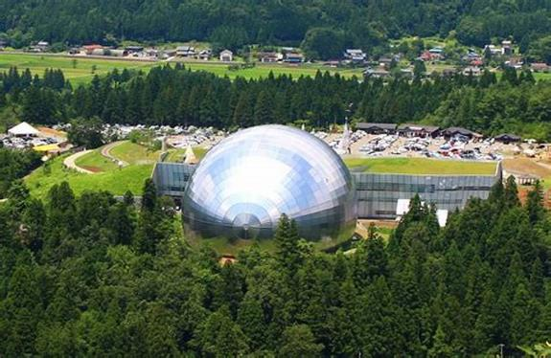
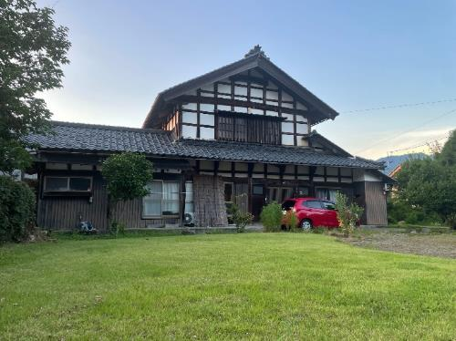

Slide 18
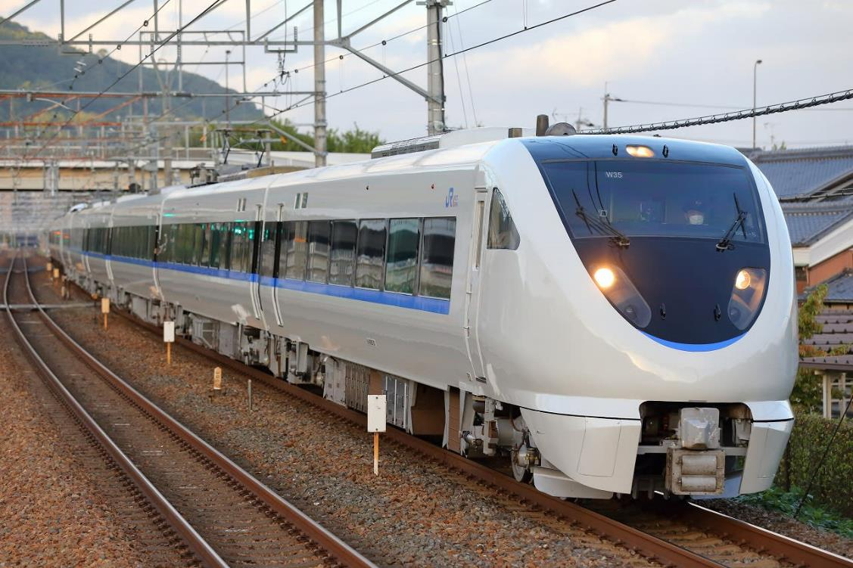
Day10 Move to Kyoto
Finally, the trip to Kyoto, the final destination. Take the Thunderbird(train) from Fukui to Kyoto. After arriving Kyoto, you will be transferred to your hotel and bid farewell to your guide.

Slide 19
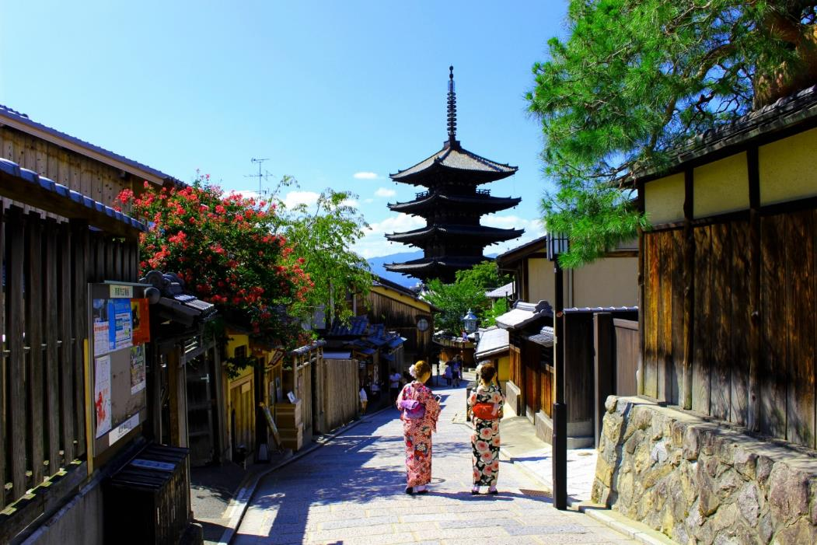
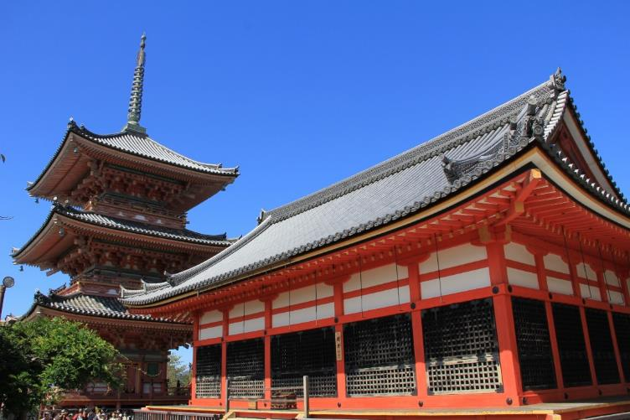
Free time in Kyoto(photos are images)

Slide 20
Day10 Move to Kyoto
Finally, the trip to Kyoto, the final destination. Take the Thunderbird(train) from Fukui to Kyoto. After arriving Kyoto, you will be transferred to your hotel and bid farewell to your guide.
Day11 Move to Kansai Airpot
It's finally time to go home. From Kyoto, take the express train to Kansai Airport.
(Customers must move by themselves)

Slide 21
Back to Hawaii
With wonderful memories in Japan to hawaii
See you again in Japan!

Slide 22
Moving Tokyo to Kyoto（Fly back from Kansai Airport)
Through Hokuriku area

Slide 23
エローラ・アジャンタ石窟群
ポイント
インド悠久の大地

Slide 24
エローラ・アジャンタ石窟群
ポイント
インド悠久の大地

