Slide 1
Only for
SAKURA season
Tama River(Okutama Area)
Cherry Blossom Viewing River Rafting By sitting on SUP and Outdoor Sauna

Slide 2
Tour Features
Sit on a stand-up paddle and down the Tama River with its cherry blossoms. The SUP rider controls the SUP.
You can see a different cherry blossom scenery from the land.
On the way, buy sake at a sake brewery and drink it while looking at the river after the finish.
Since it uses a large SUP, it BASICALLY does not fall into the river.
After the SUP, guests can enjoy an outdoor sauna and cooling off in the river.
When you get out of the river, take a shower and have lunch at a place where you can see the river.
Pick-up and drop-off to JR stations included

Slide 3
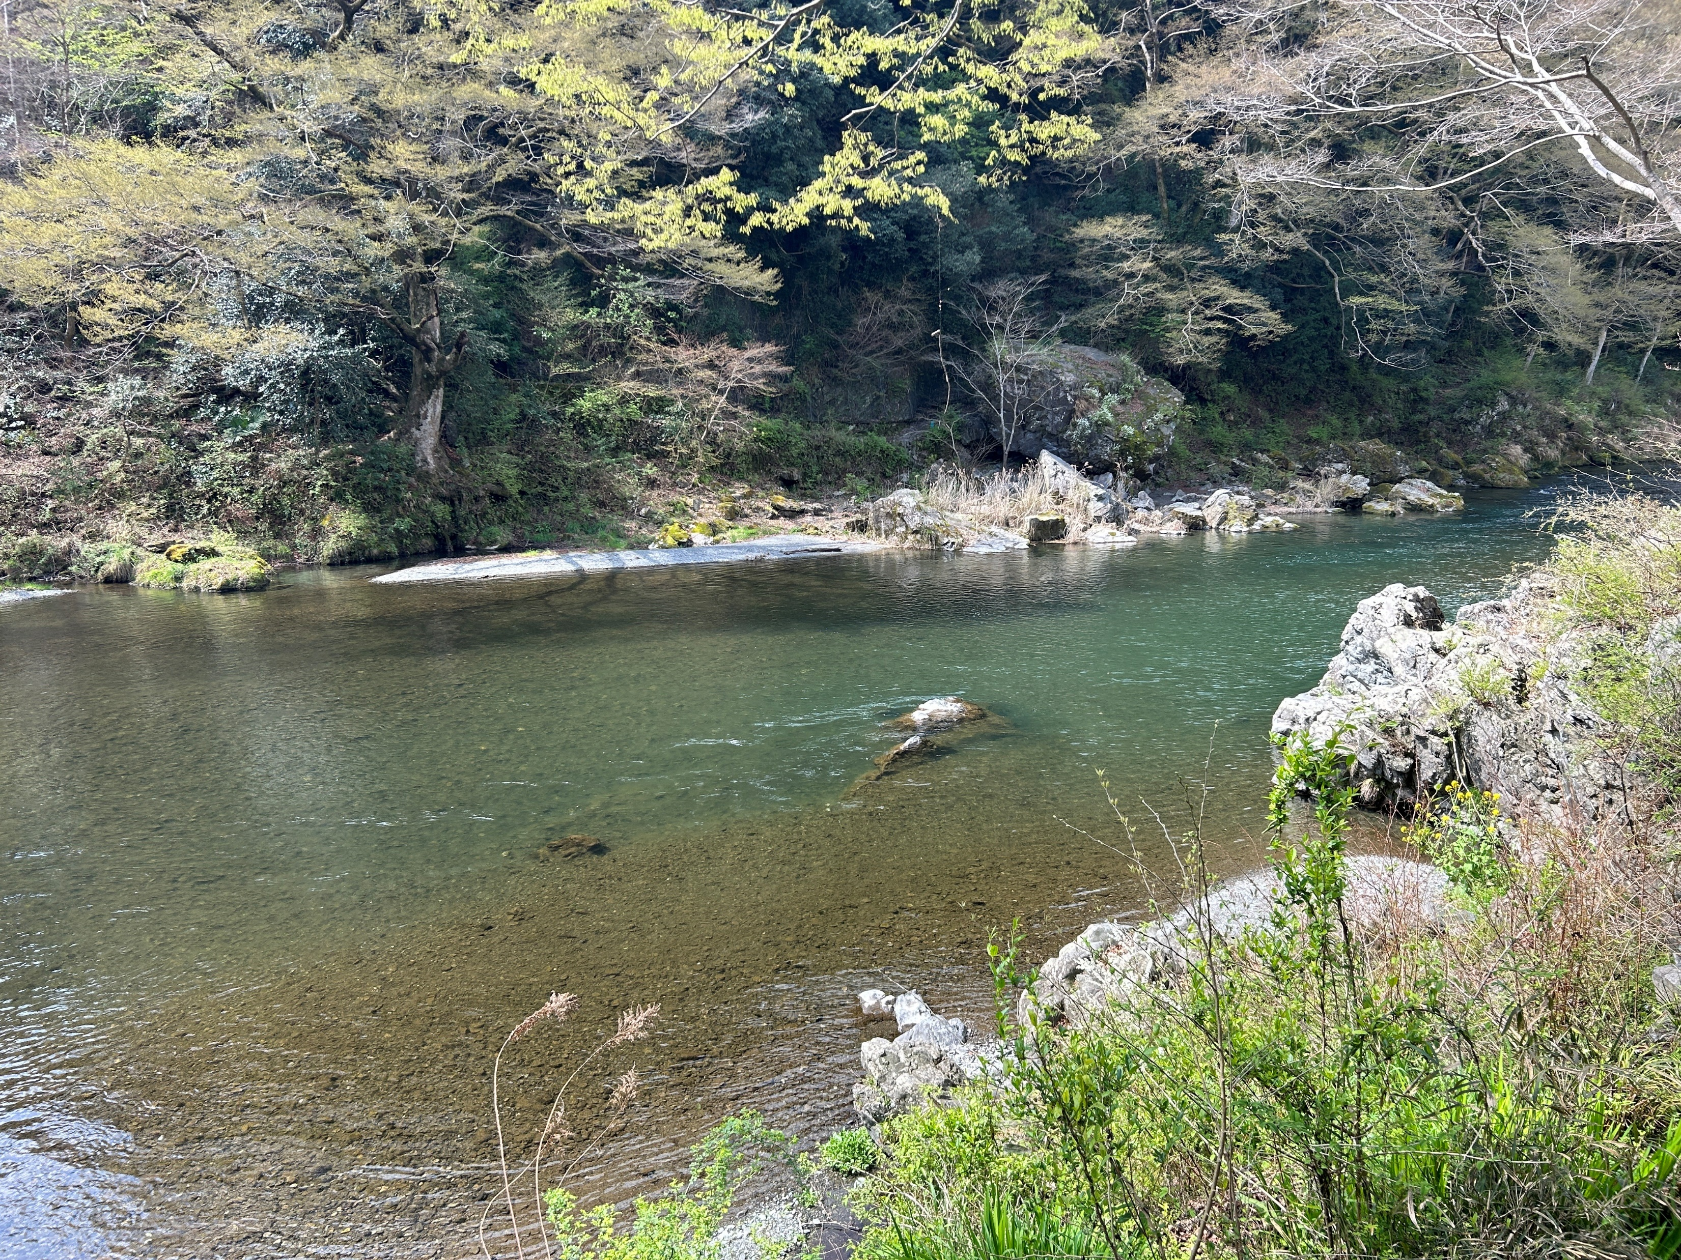
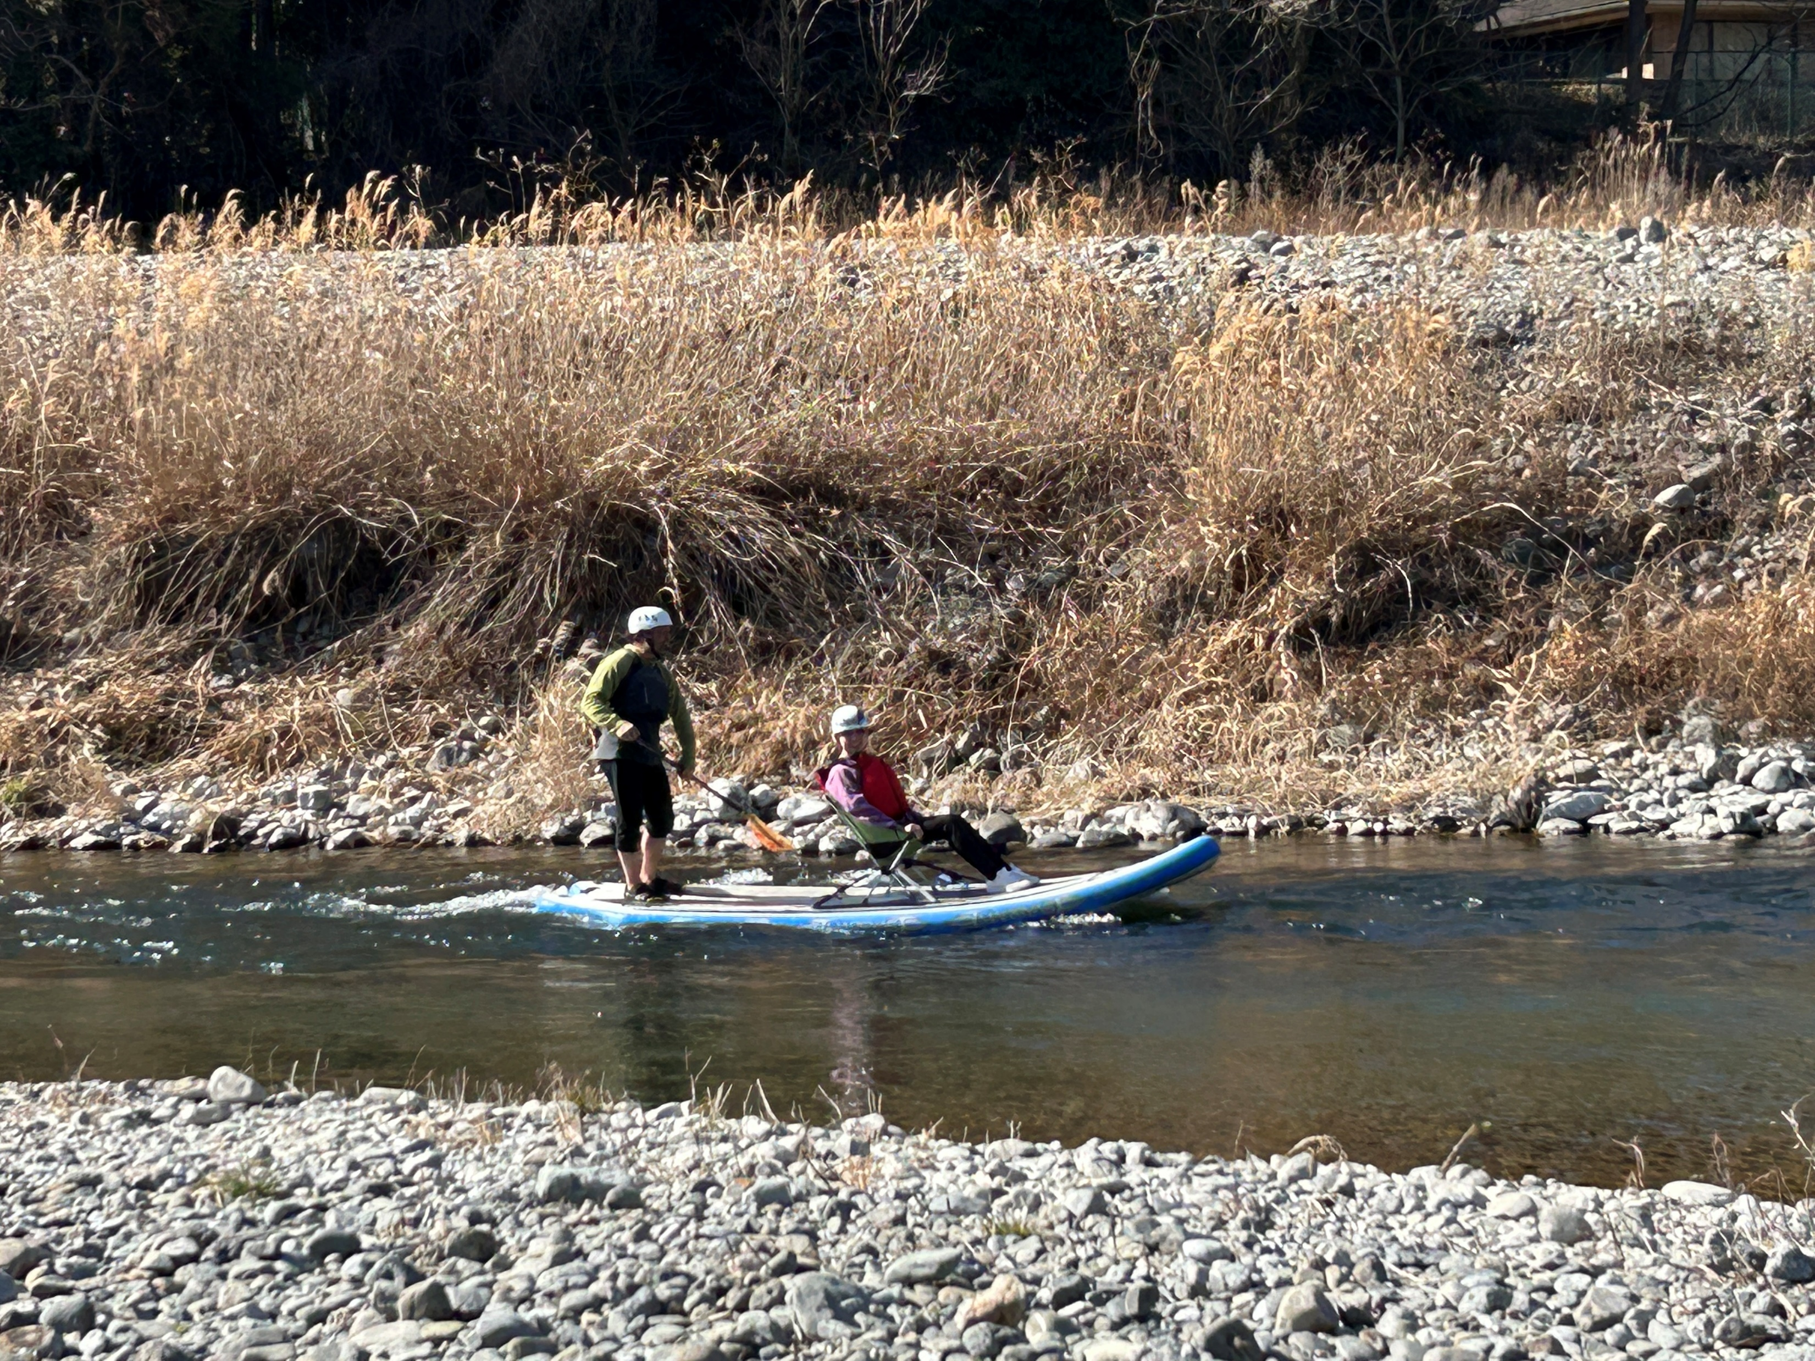
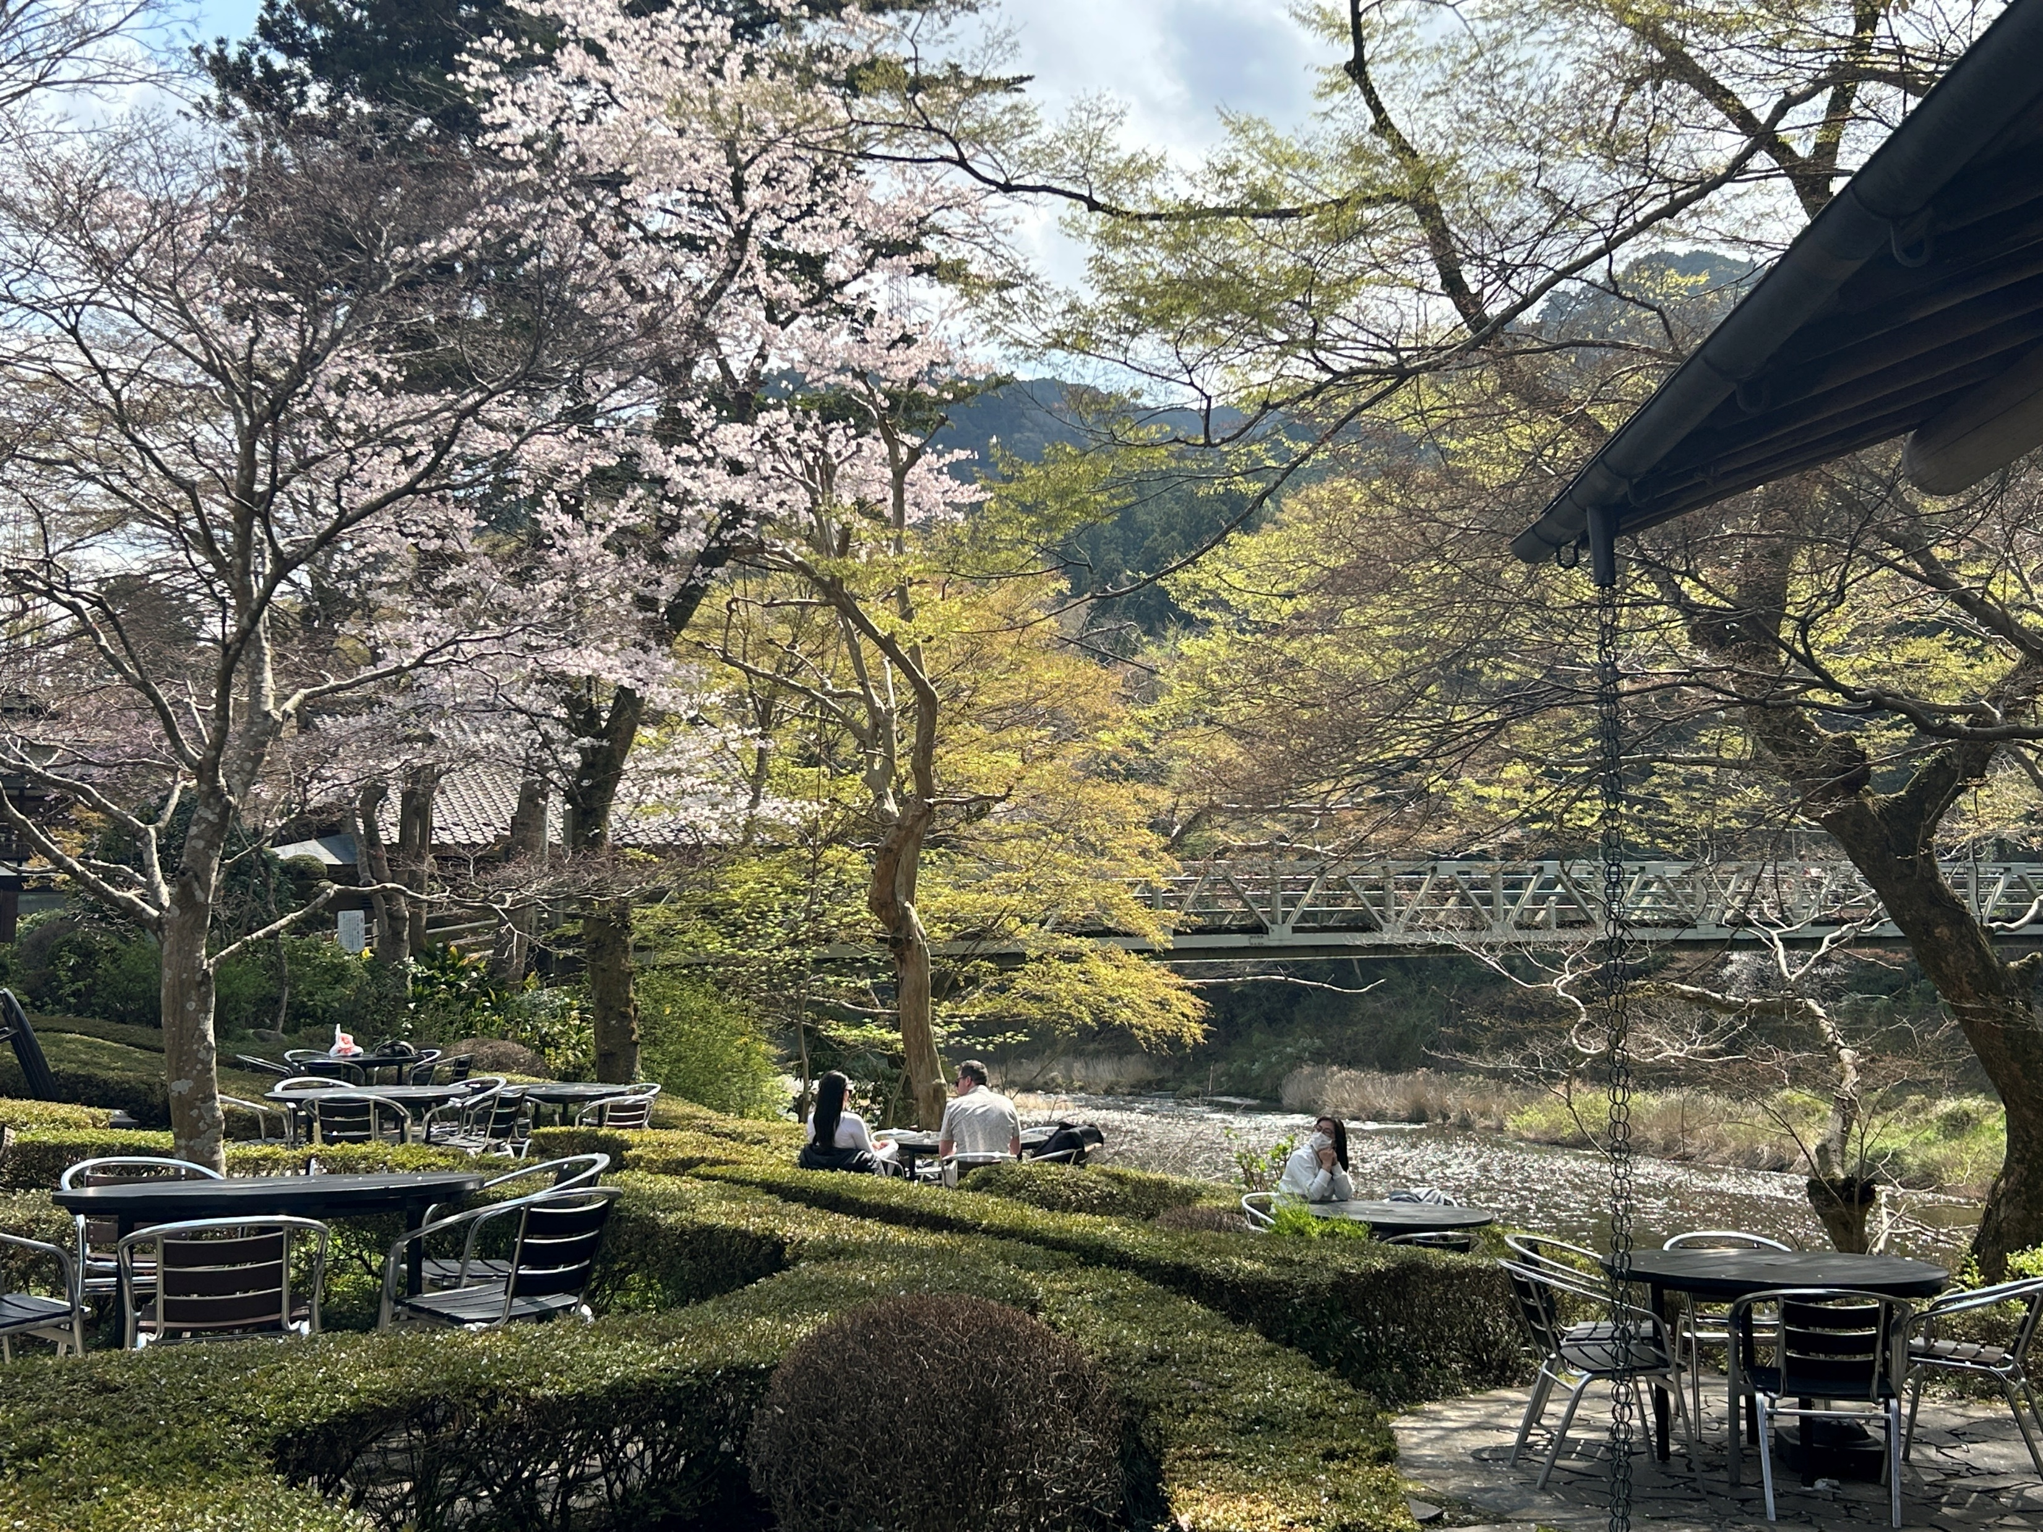
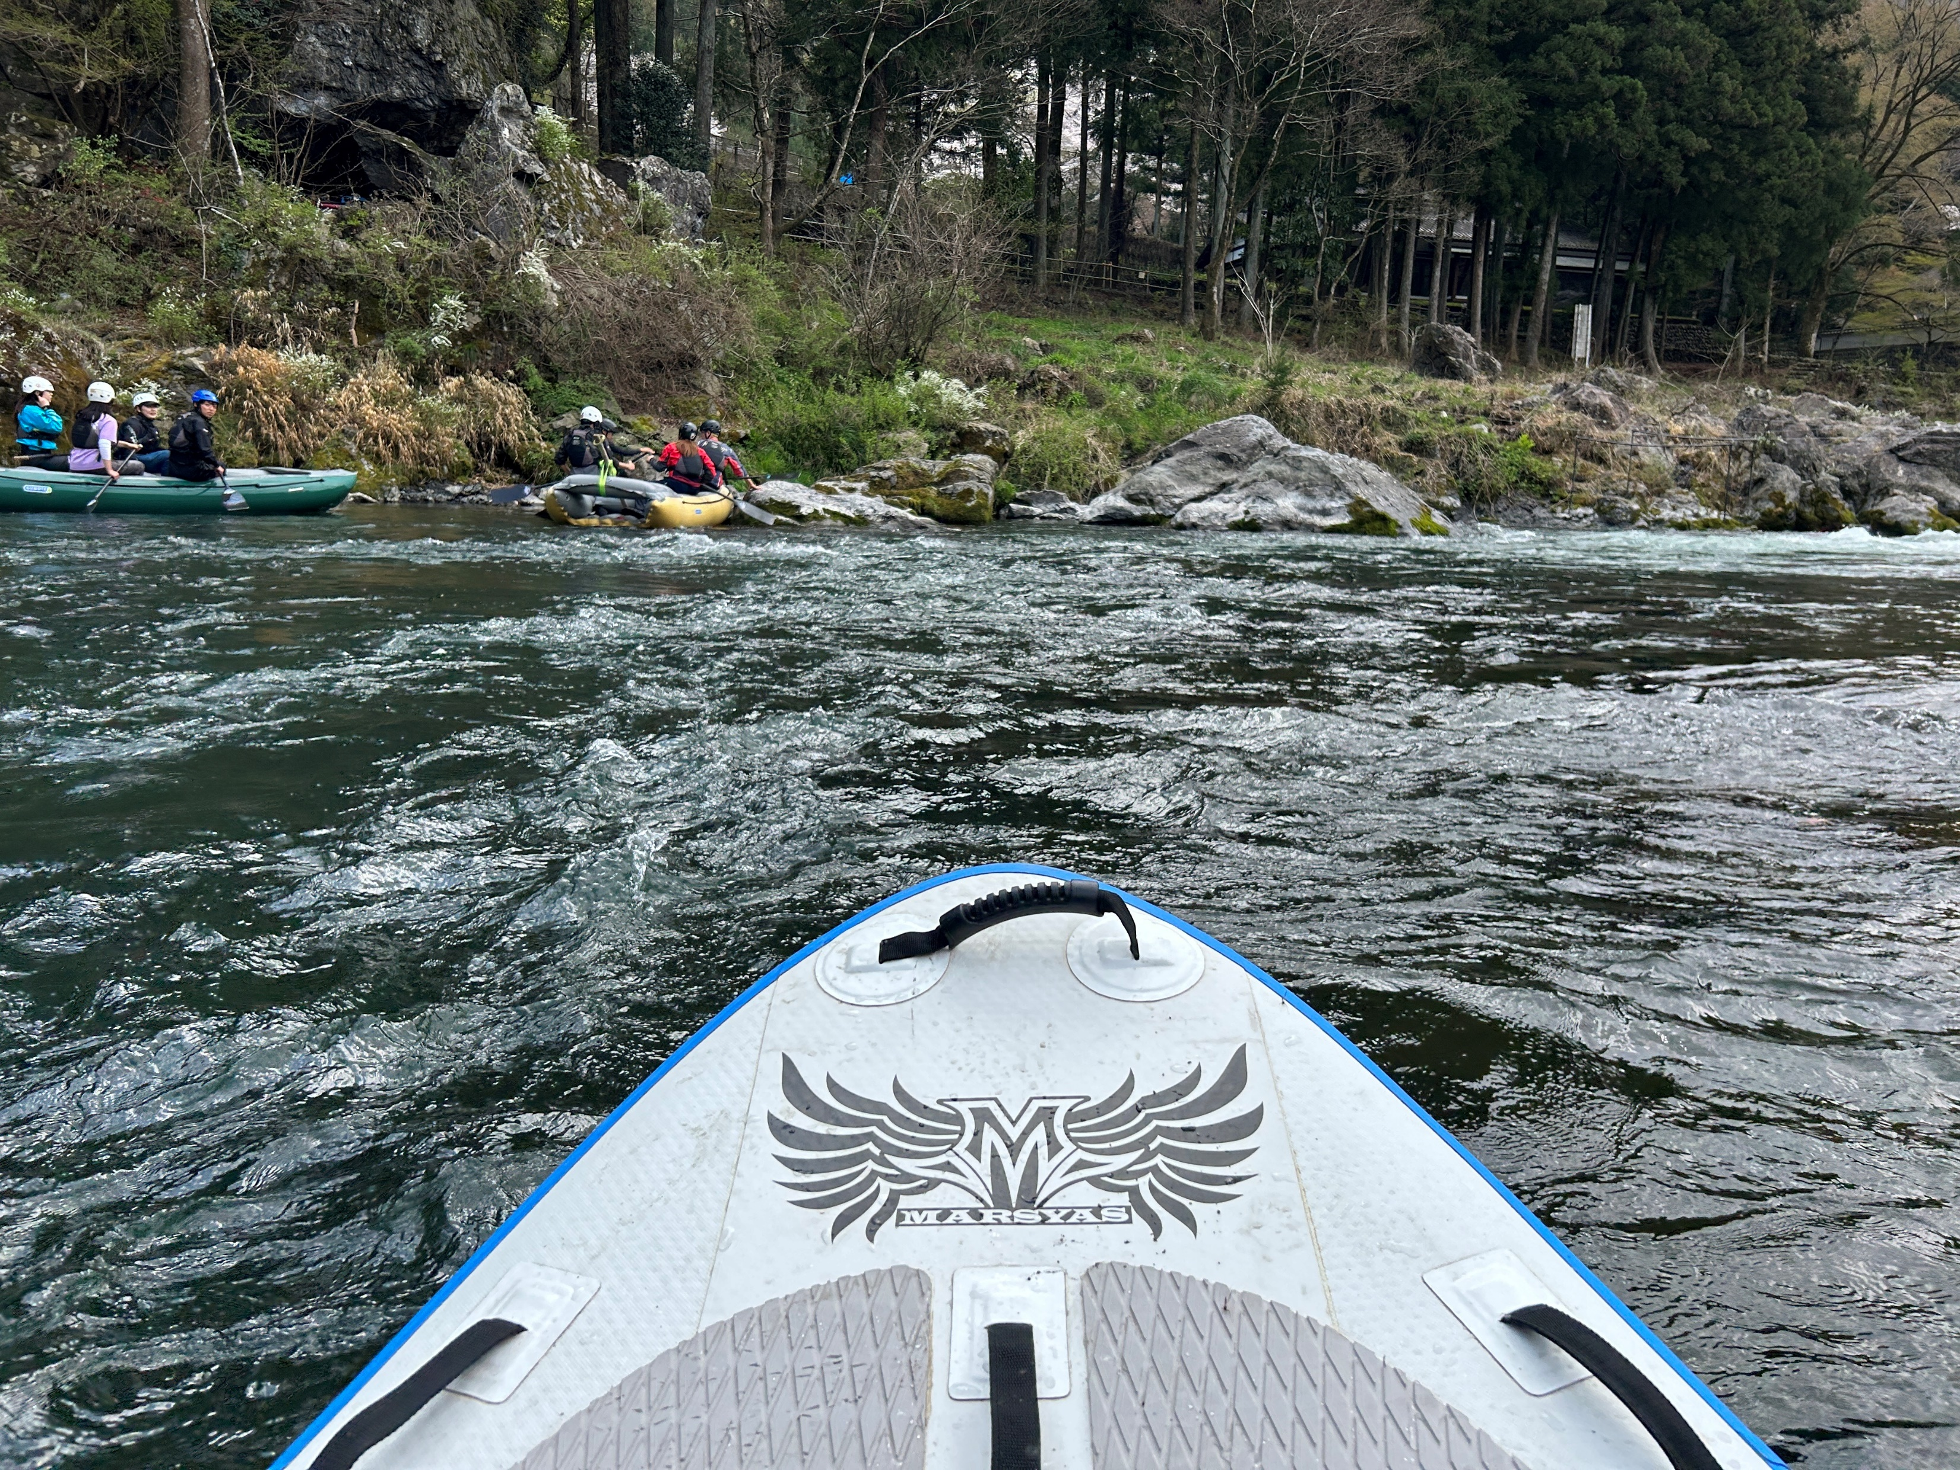
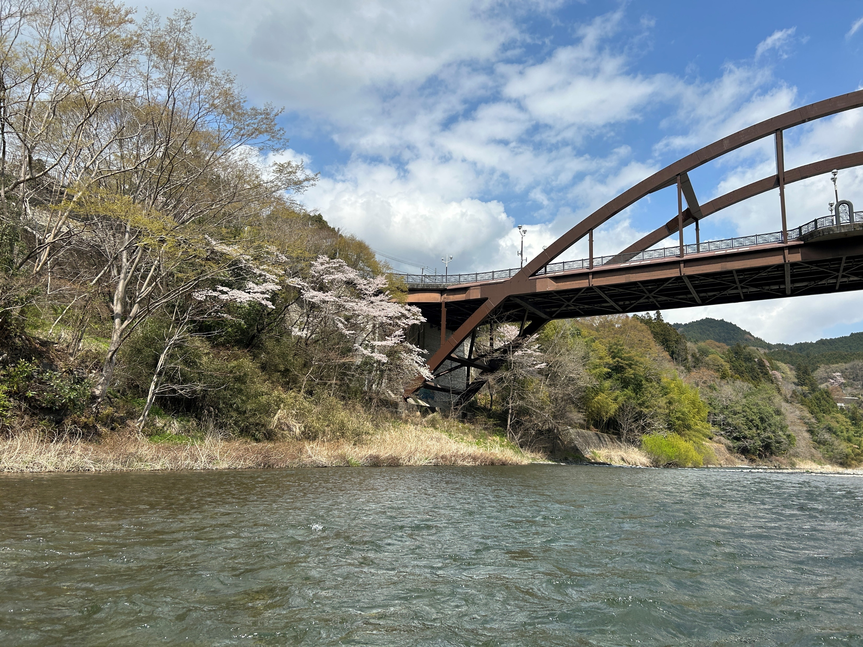
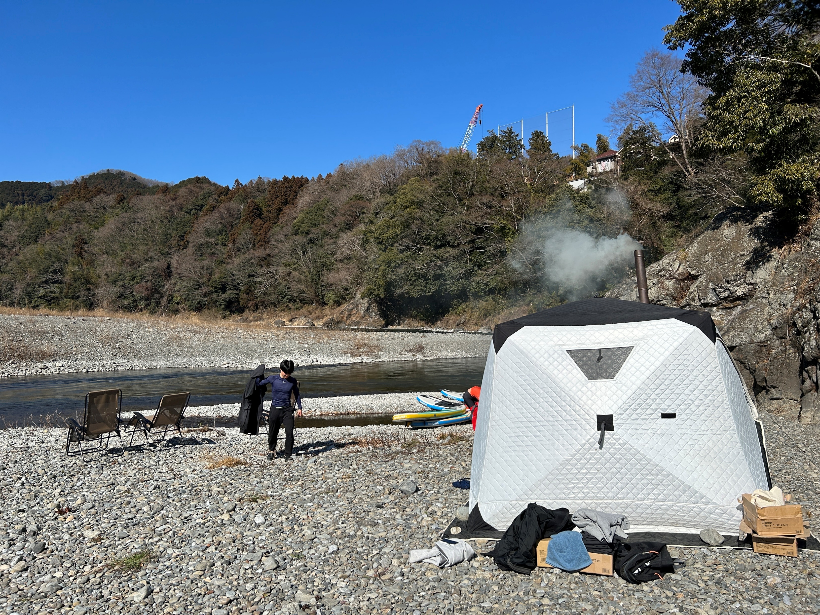
Tour Schedule
【Morning Time】
0900 Meet @Mitake Station
0930 SUP River Rafting Start
Stop at the Sake brewery
1100 Outdoor Sauna
1200 Lunch
1300 Bye @Oume Station
【Afternoon Time】
1200 Meet @Oume Station
1215 Lunch
1315 SUP River Rafting Start
Stop at the Sake brewery
1445 Outdoor Sauna
1600 Bye @Oume Station

Slide 4
Included in the tour fee
1～1.5h SUP down the River Experience
The SUP rider controls SUP, You just sit on the SUP.
Wet Suite rental
Lunch(Bento Box(beef,fish,or vegetables)
Outdoor Sauna(1h)
Insurance

Slide 5
Tour fee
18,000 Per Person
Minimum 2 PAX Maximum 3PAX in each Time.
Under 10 years old can’t participate
Attentions
Depending on the conditions of the river, it may be canceled on the day.
We use a large SUP, but you may fall into the river.
Conditions of the river, it may be canceled on the day.
To participate, you will be asked to sign a pledge at the site.Minimum 2 PAX
Attention: Depending on the conditions of the river, it may be canceled on the day.
Attention2:We use a large SUP, but you may fall into the rive

Slide 6
Cancellation Policy
2 days before the tour:30% of the tour fee
1 day before the tour:50% of the tour fee
On the day of the tour:100% of the tour fee
In case of cancellation, please contact us at 03-6380-8350. (10a.m～
6 p.m. on weekdays)
For other days and times, please contact us by e-mail. E-mail address: info@sawakami.tours

Slide 7
What to bring
Swimsuits, T-shirts, shorts
Cash（if you buy Sake)
Towel (Local Sale:1000yen)
Shoes or sandals that can get wet (with a fixed heel)(Local Shoes Rental:500yen)

Slide 8
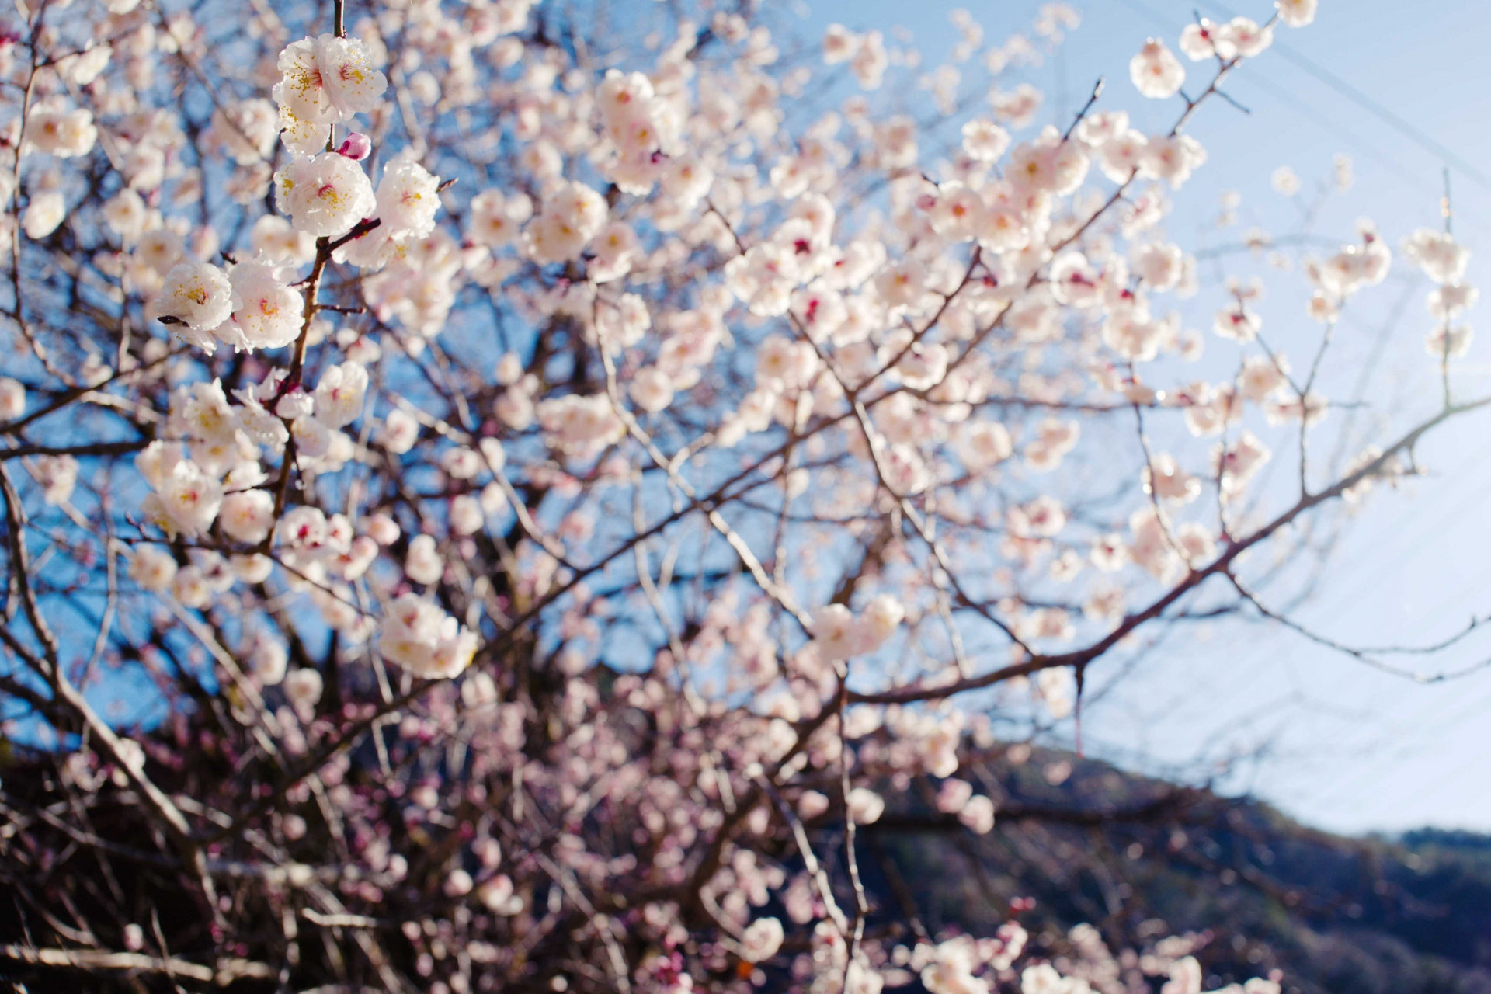
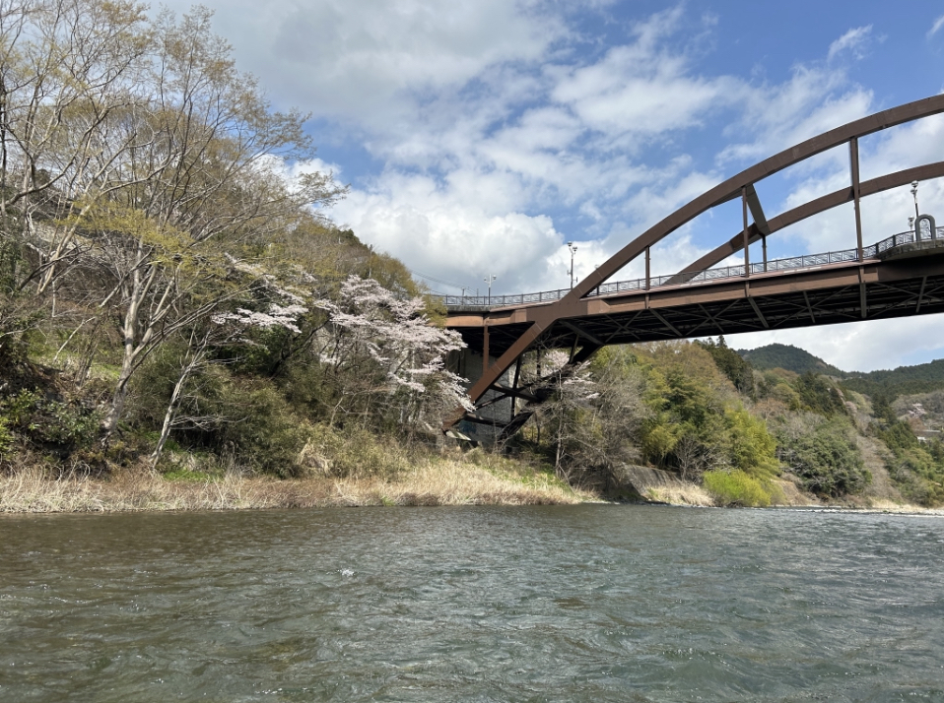
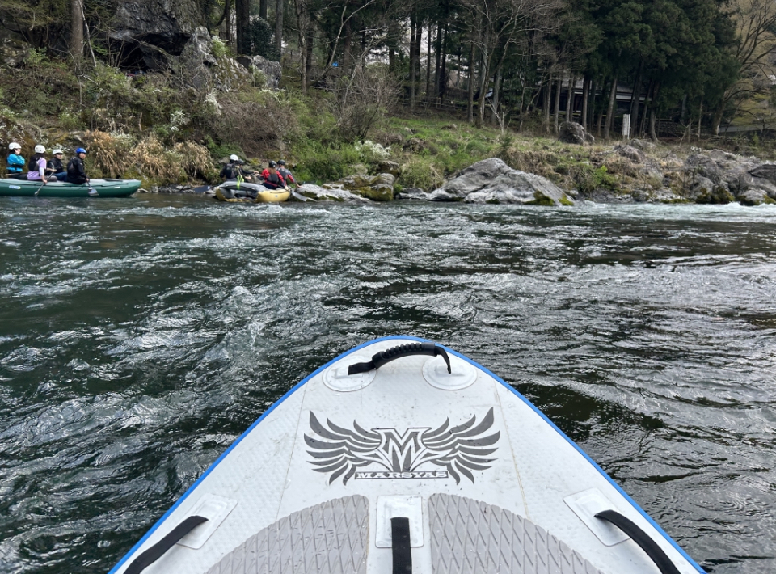
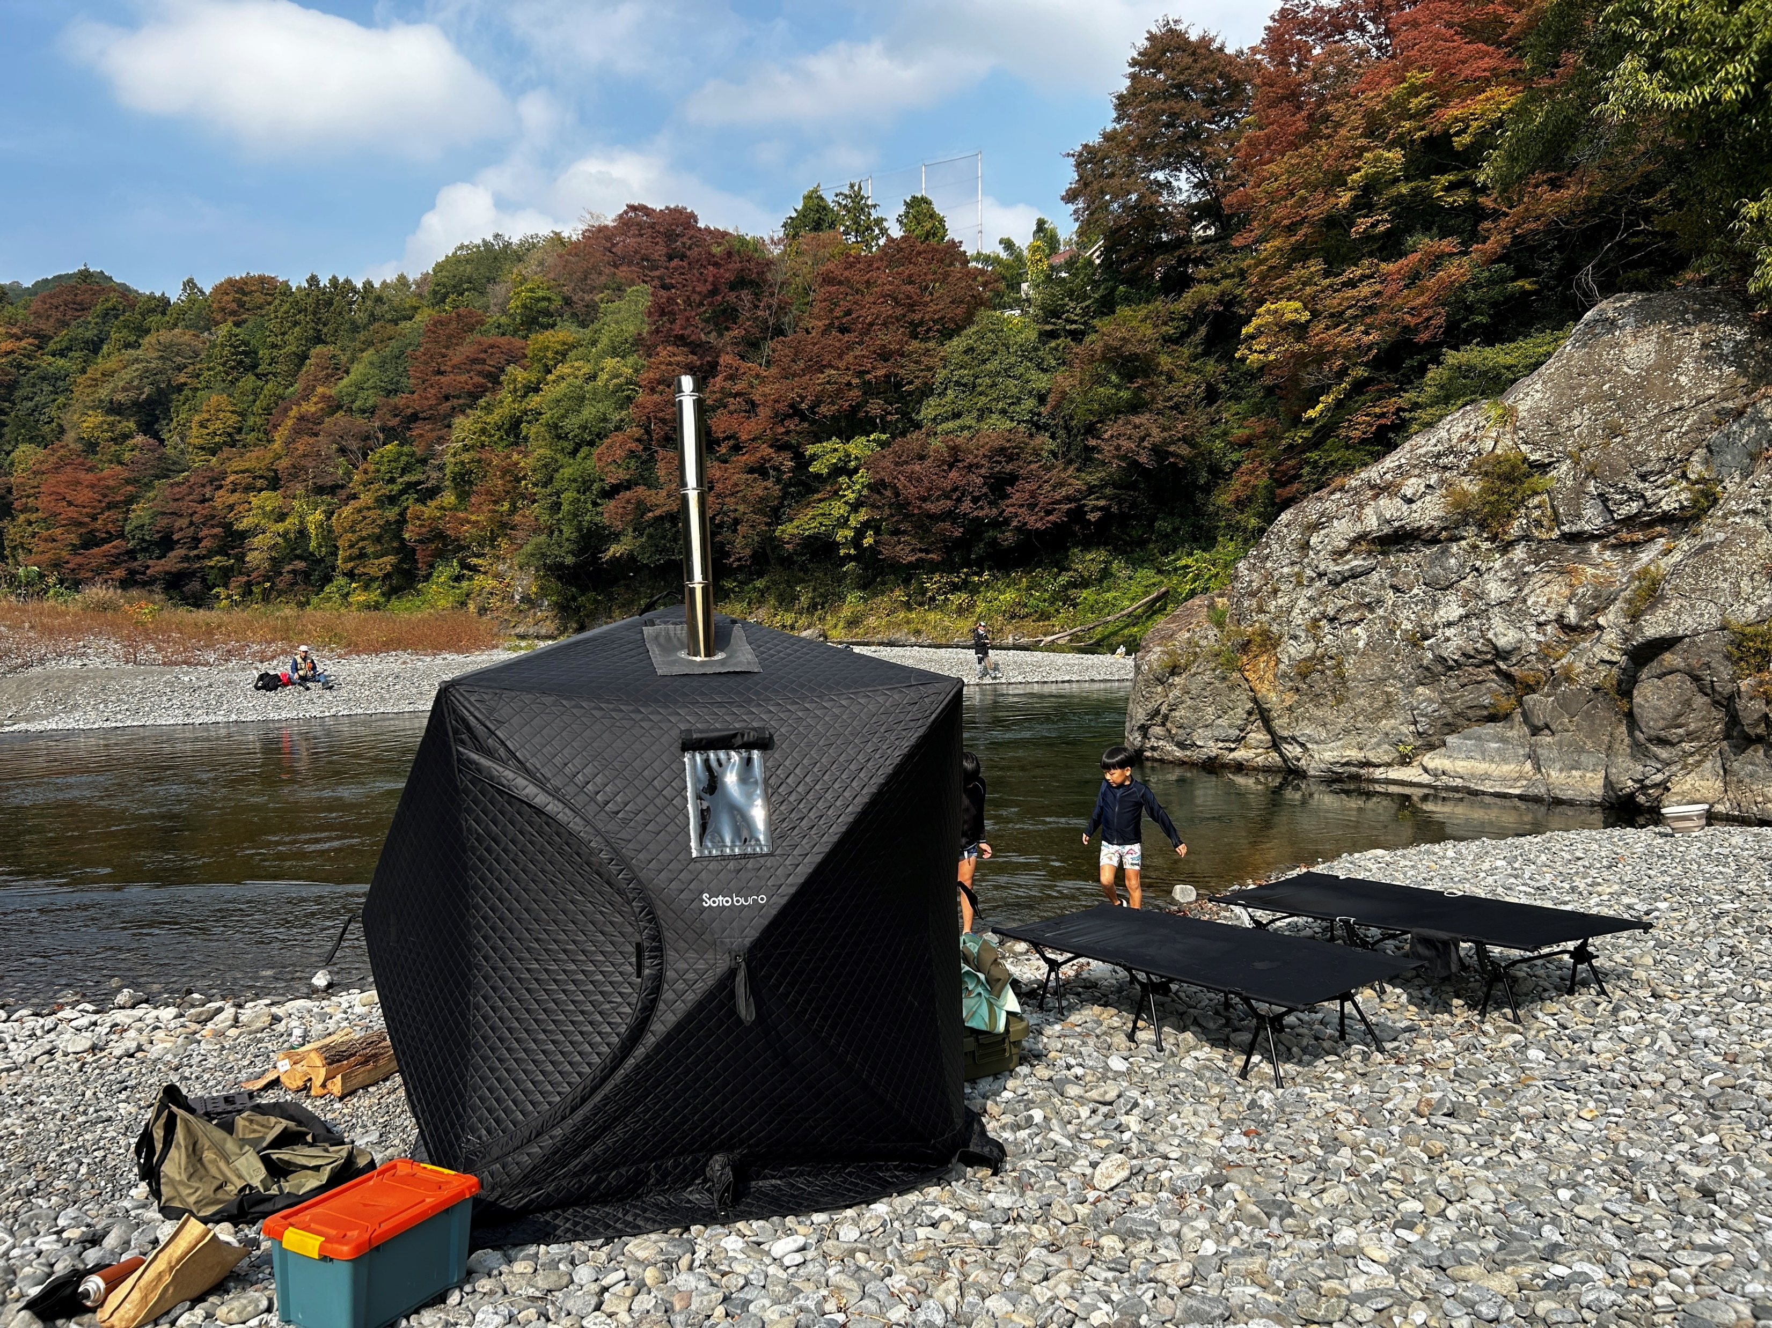
Image Photo

